Slide 1
Database Systems: Theory and Programming Java Persistence
Notes:
Replace this with your course title and your name/contact details.

Slide 2
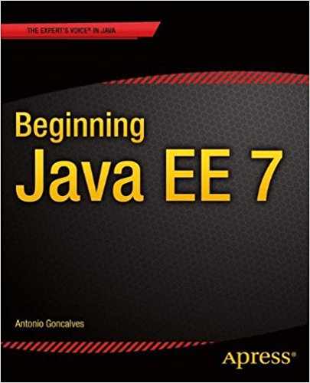
Acknowledgements
Material and examples for this PowerPoint deck come from:
Beginning Java EE 7, Antonio Goncalves, December 7, 2015.

Slide 3
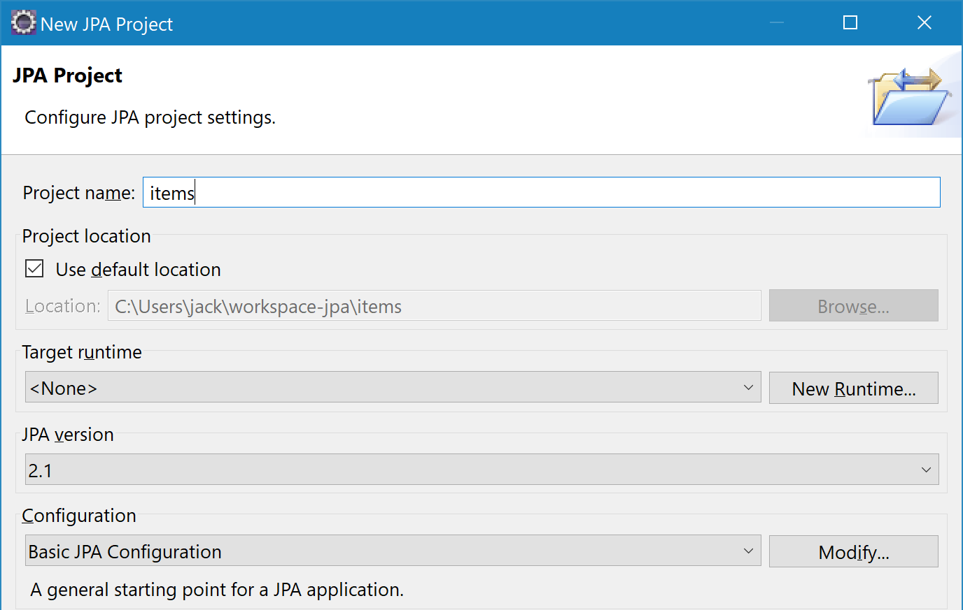
Eclipse set up (1)
Create a new JPA project
Configure for Apache Tomcat and create a new local server
make new runtime

Slide 4
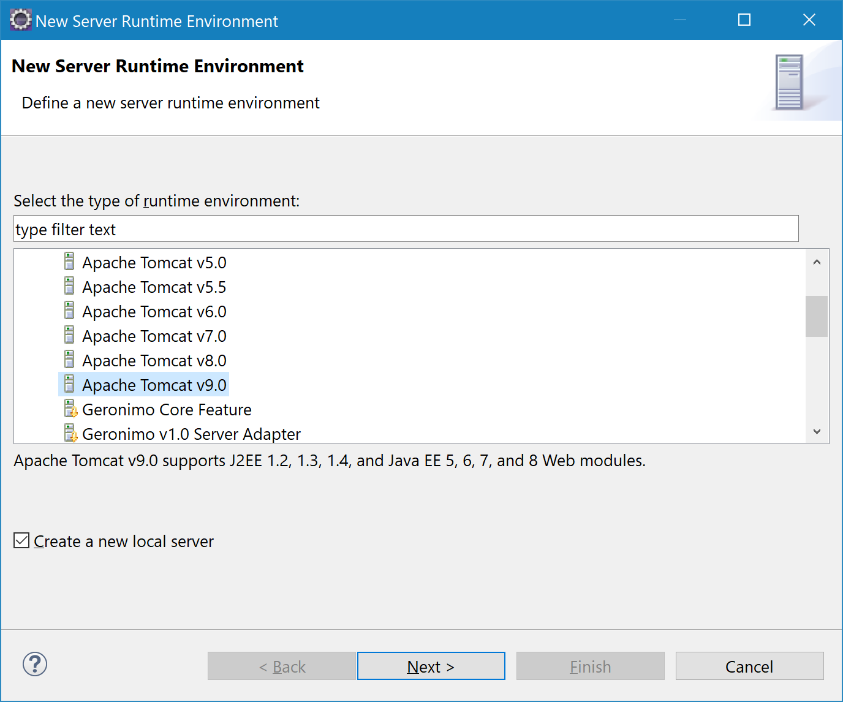
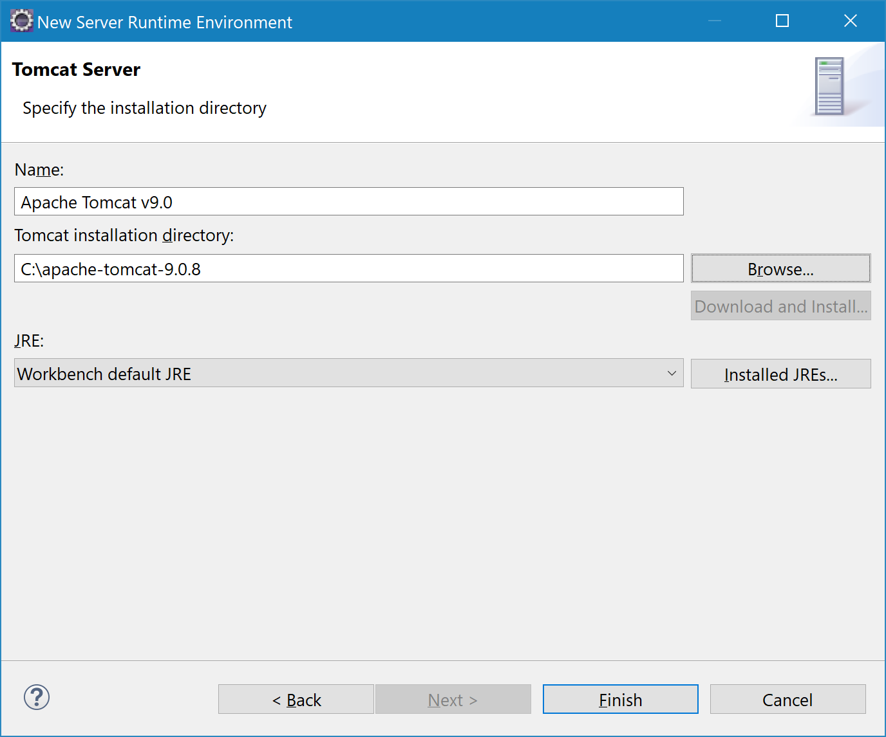
Eclipse set up (2)
Select the appropriate Tomcat version
NOTE: You will need to already have installed Tomcat

Slide 5
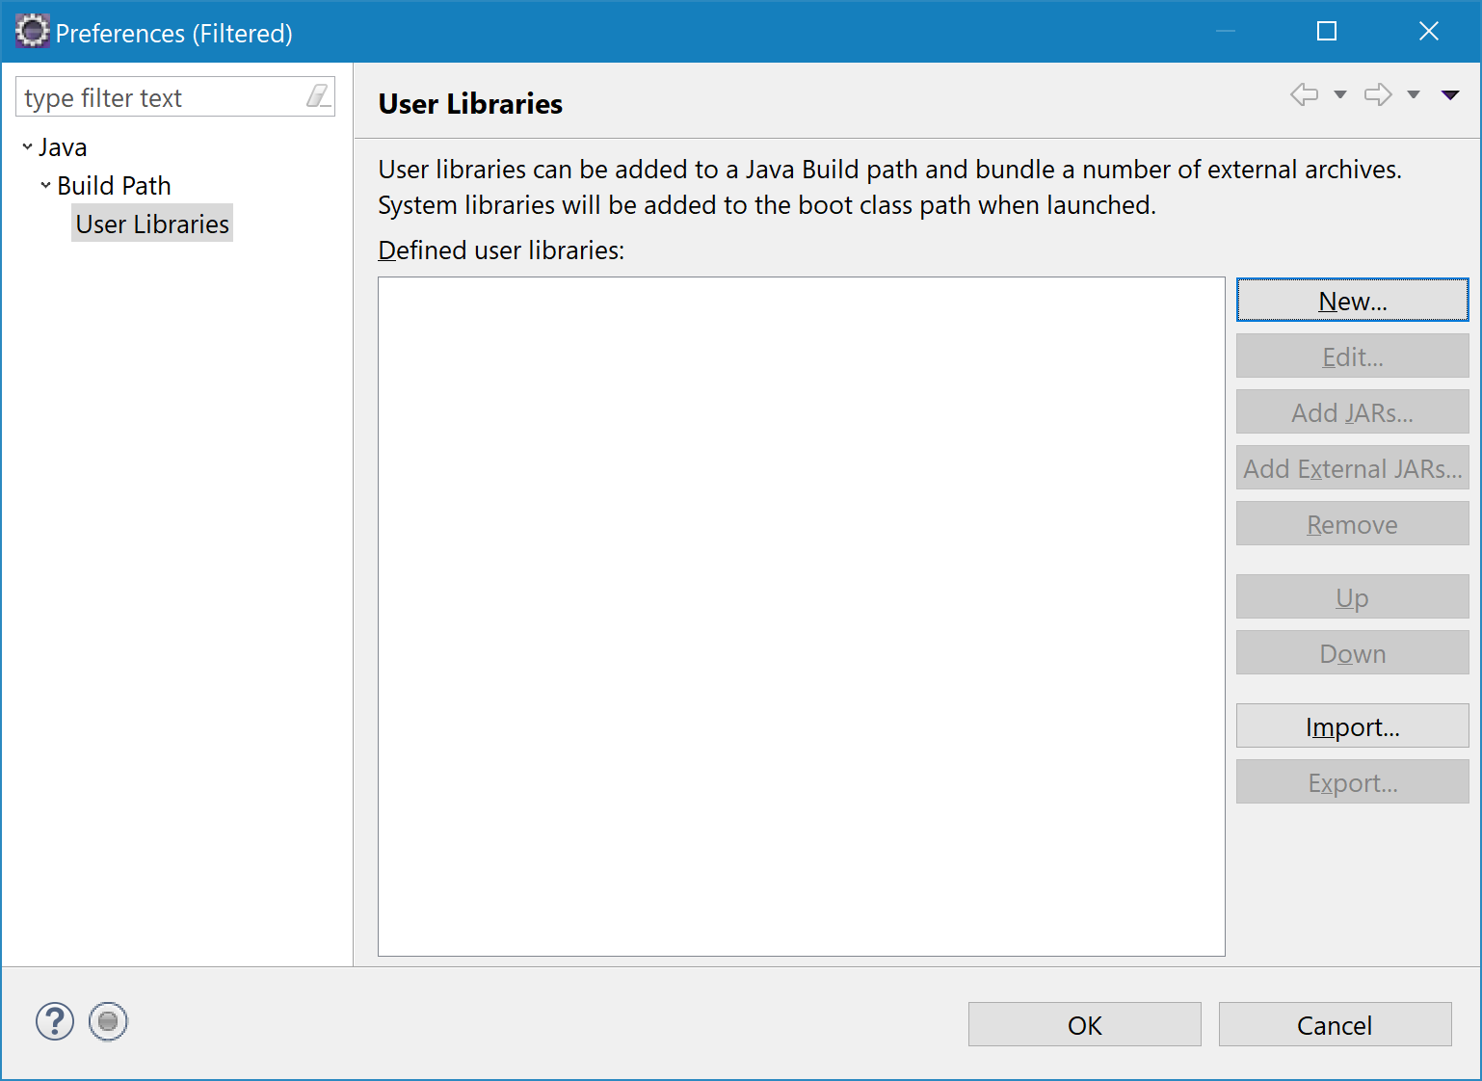
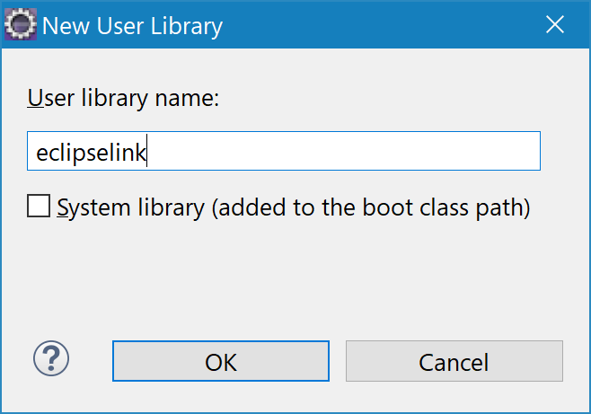
Eclipse set up (3)
Add the JPA libraries to the Build Path in a new Library (found in jlib folder)

Slide 6
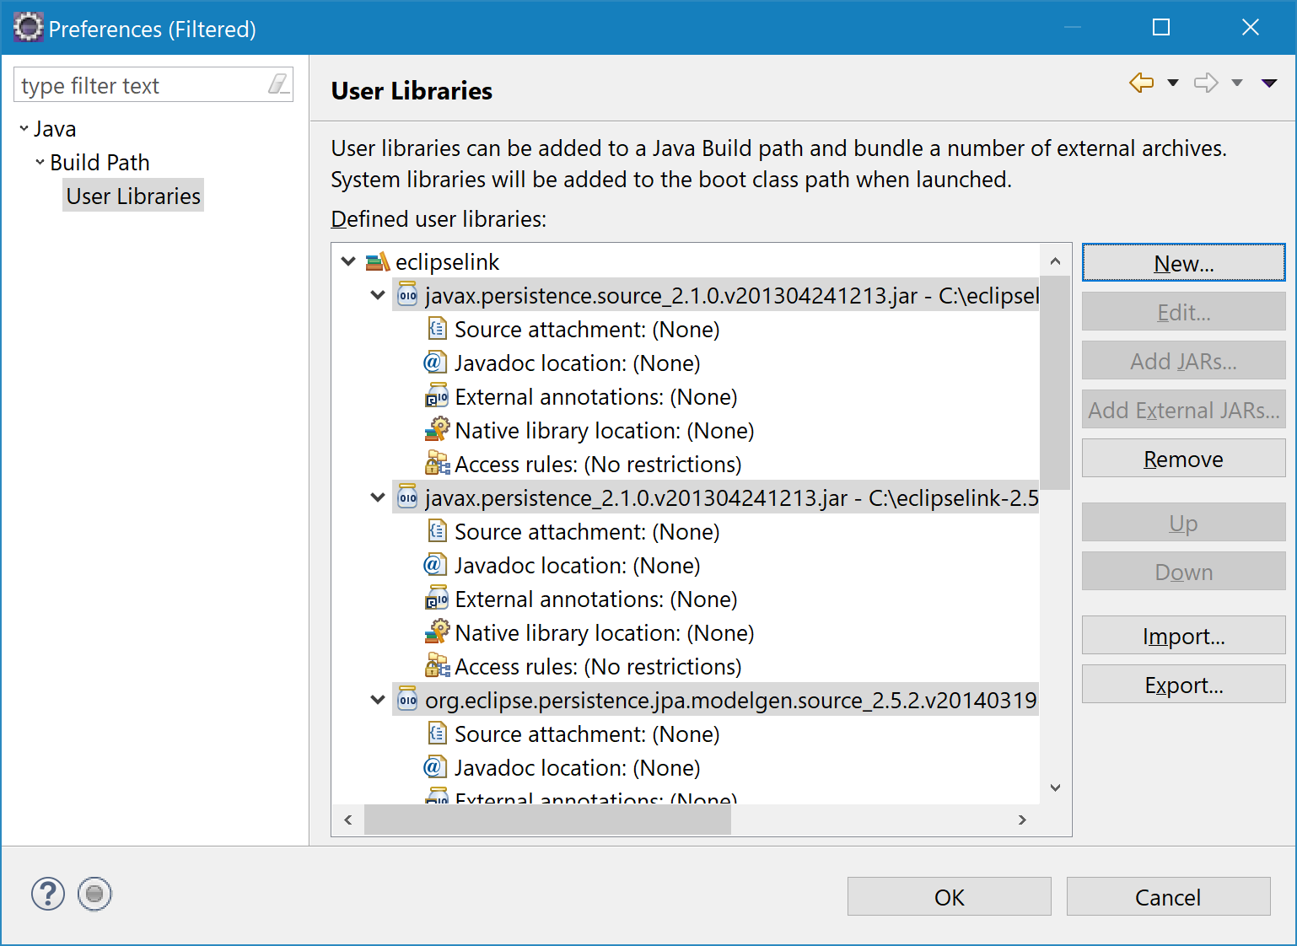
Eclipse set up (4)
Include main eclipselink JAR file as external JAR
Also include all JPA JAR files as external JARs

Slide 7
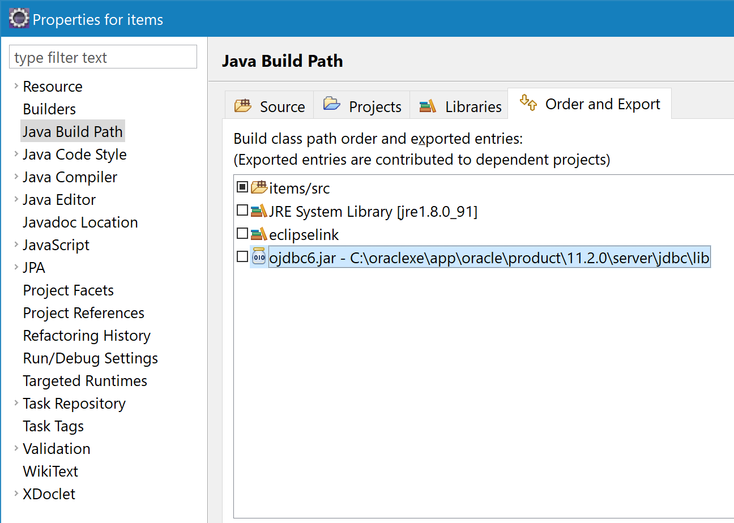
Eclipse set up (5)
Your Java build path must include eclipselink and ojdbc.

Slide 8
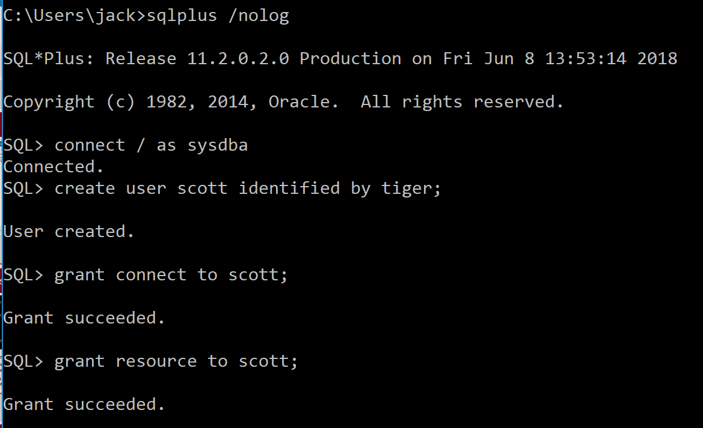
Set up an Oracle User
Fun facts about scott/tiger
If you’re not familiar, scott used to be one of the seeded users that came with a fresh Oracle DB install. His password was tiger.
Bruce Scott was one of the first employees at Oracle, and his daughter had a cat named Tiger.

Slide 9
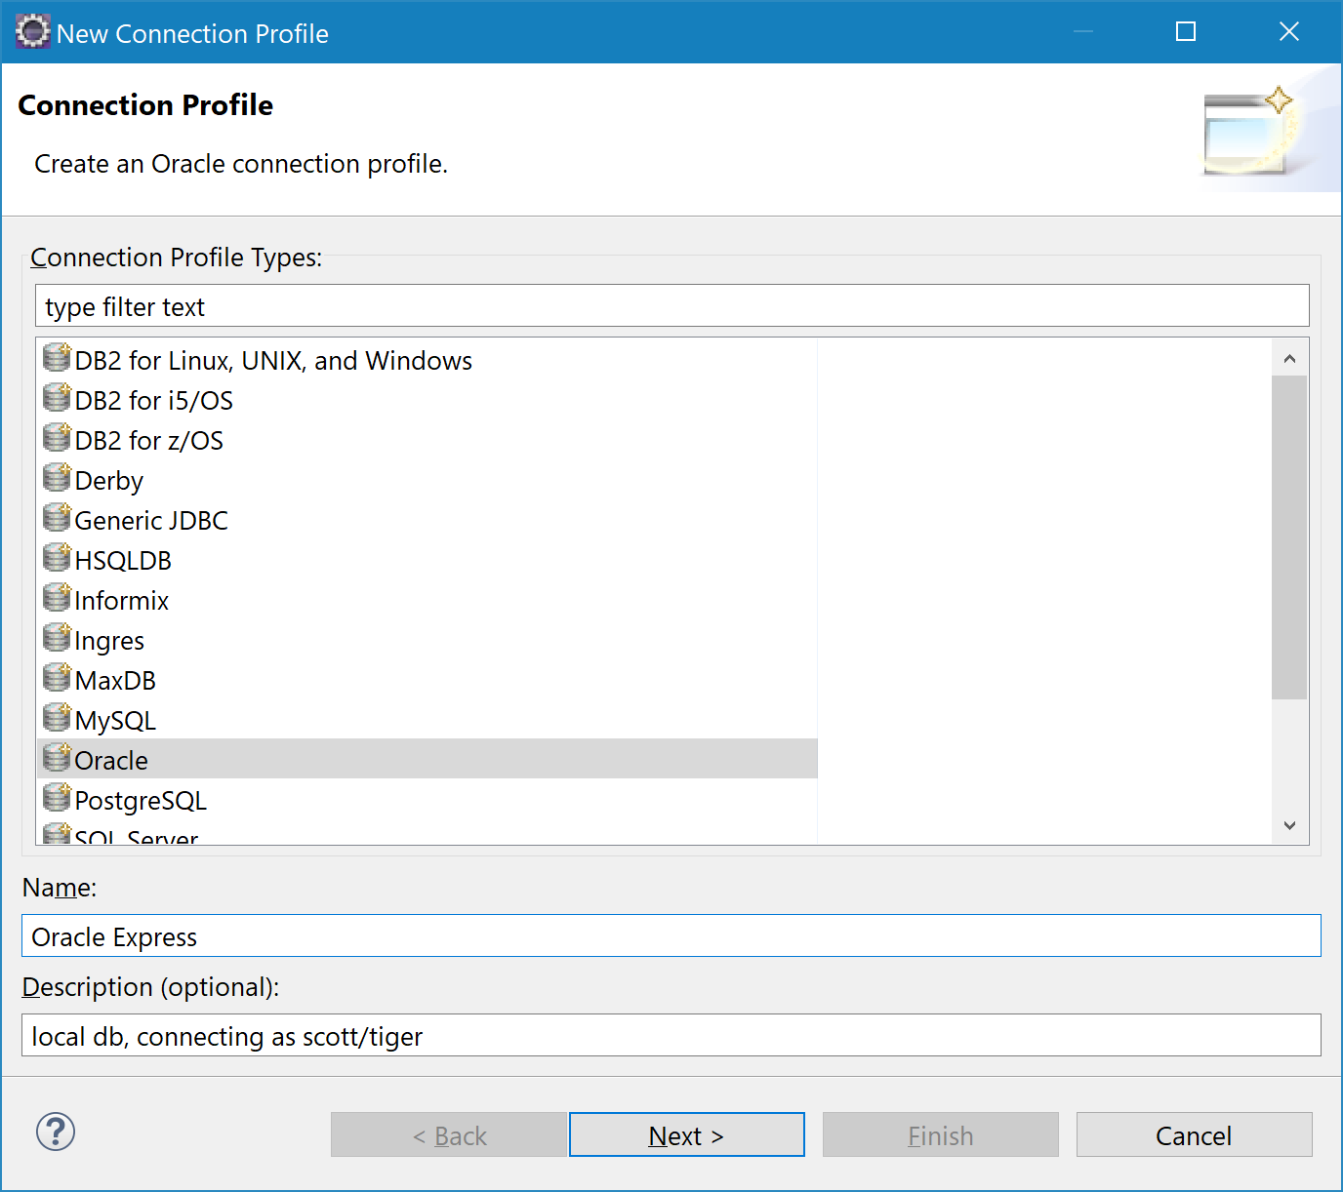
Connecting to Oracle (1)
Now, for your JPA project, you will need an Oracle connection
From Eclipse, click Windows > Open Perspective > Other from the Main menu, and then select Database Development
Highlight Database Connections (in Data Source Explorer) and add a new Connection Profile

Slide 10
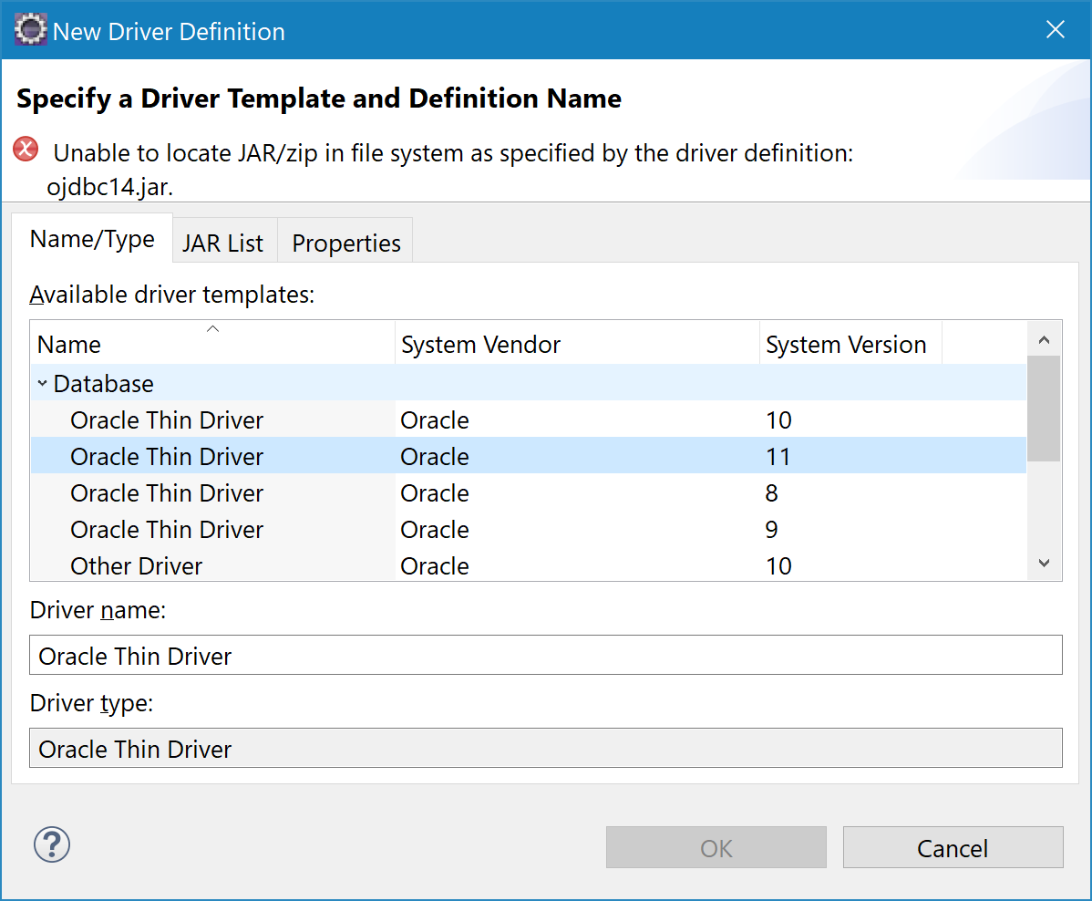
Connecting to Oracle (2)
Now, for your JPA project, you will need an Oracle connection
From Eclipse, click Windows > Open Perspective > Other from the Main menu, and then select Database Development
Highlight Database Connections (in Data Source Explorer) and add a new Connection Profile
Express

Slide 11
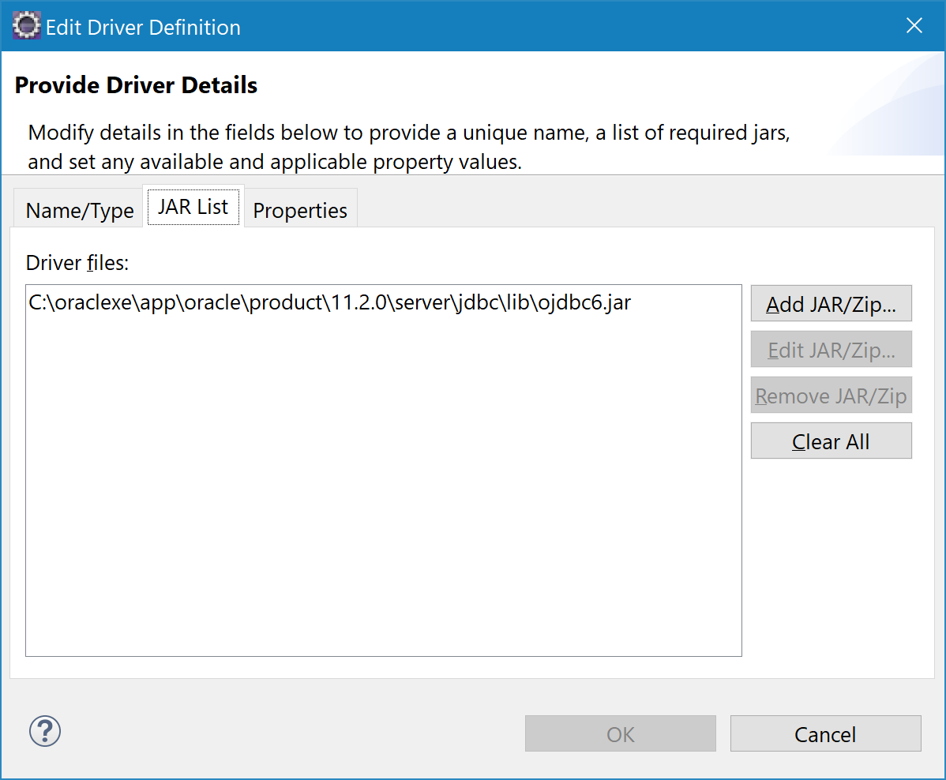
Connecting to Oracle (3)
Add the ojdbc jar file
Yes, ojdbc needs to be here and in your Java build path.

Slide 12
Connecting to Oracle (4)
Add the ojdbc jar file

Slide 13
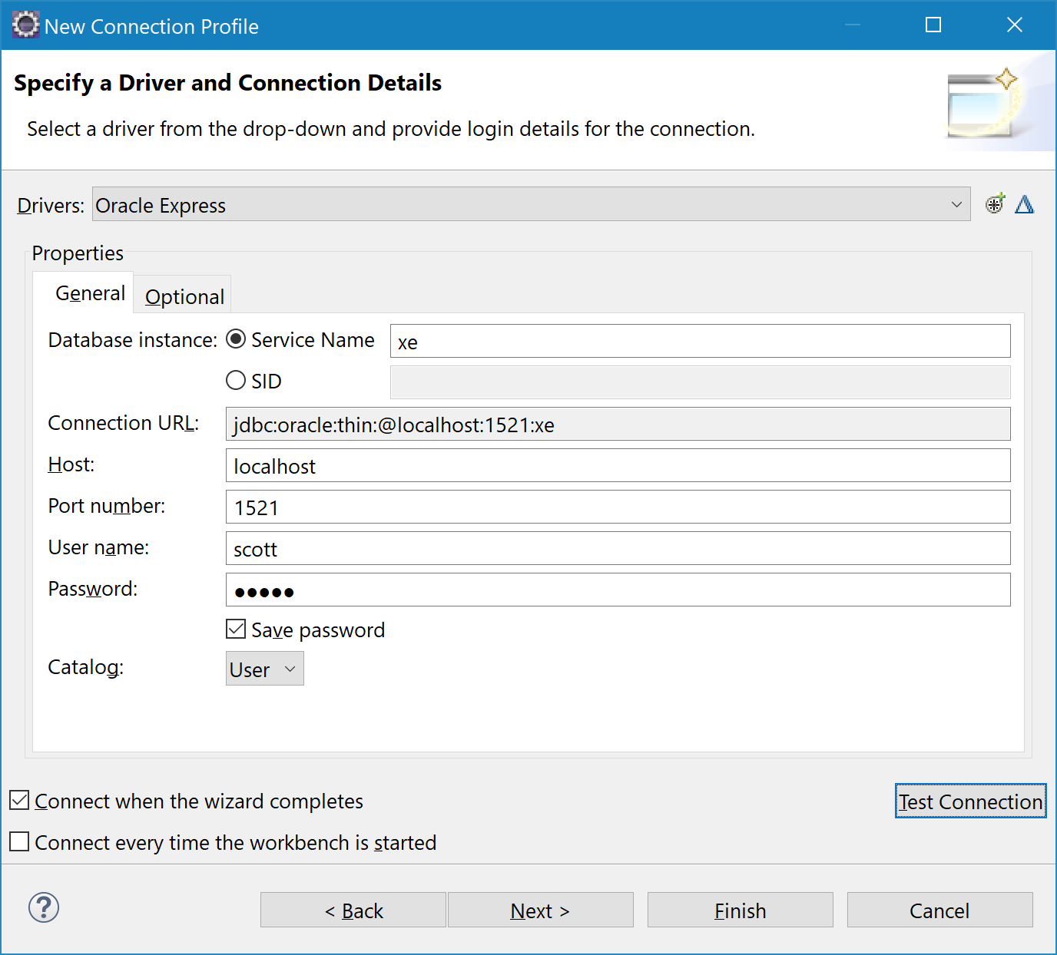
Connecting to Oracle (5)
Make the host localhost
The database for Oracle Express is "xe"
Add scott/tiger

Slide 14
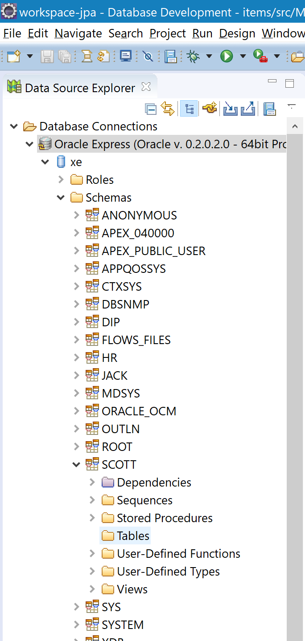
Use Eclipse to access databases
From Eclipse's Database Development perspective, you can browse Oracle
Here's scott

Slide 15
Persistence Java Persistence
Databases and Persistence
Java Persistence API (JPA)
Building a sample application

Slide 16
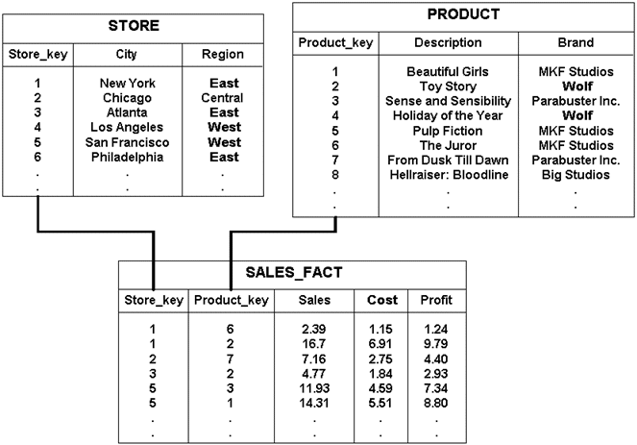
The Role of Databases in Java
Most data we manipulate stored in relational DBs.
Primary keys
Foreign keys
All unknown to object-oriented Java which understands
Concrete classes
Abstract classes
Interfaces
Enumerations
Instances of classes encapsulate state and behavior but this state is only available when the JVM is running.
Persistent data is stored on permanent memory
Table joins
Integrity constraints
Database
Inheritance
Annotations
Methods
Attributes
Notes:
Concrete class: class that can be instantiated
Abstract class: class that cannot be instantiated. Methods are to be implemented by descendants.
Interfaces: the name of the class, its purpose, a list of constructors and methods including their purpose, parameters/return types for methods
Enumerations: data type consisting of a set of values; e.g., enum Cardsuit { CLUBS, DIAMONDS, SPADES, HEARTS };
Annotations: metadata in the class files; e.g. @Override, @Deprecated

Slide 17
Ways to Achieve Persistence
Serialization
Convert an object into a series of bits on a disk or over a network connection (e.g., Internet) using the java.io.Serializable interface.
PRO: Simple; CONs: No query language No infrastructure to support heavy concurrent access or clustering.
Java Database Connectivity (JDBC)
Standard API to connect to a relational database and return a result
Session data is stored in a database table
PROs: Widely used, well tested and understood. CONs: Becoming eclipsed by Object Relational Mapping (ORM) tools
ORM
Delegating access to relational databases to external tools or frameworks
Java Persistence API (JPA)

Slide 18

✓ Concept Check: Instance versus Entity
Instances are instantiated objects that just live in memory.
Entities are objects that live shortly in memory and persistently in a database.
Entities can also be concrete or abstract, support inheritance, and function exactly as instances would.

Slide 19
Java Persistence API (JPA)
Abstraction above JDBC which makes it independent from SQL
Classes and annotations of the API in javax.persistence package
Components:
Object Relational Mapping (ORM): maps objects to data stored in relational DB
Entity manager API: for DB operations, (e.g., Create, Read, Update, Delete…)
Java Persistence Query Language: enables object-oriented data retrieval
Java Transaction API (JTA): controls transactions and locking mechanisms
Callbacks and listeners: to hook business logic into the lifecycle of a persistent object

Slide 20
How JPA Works
"Object World"
Classes
Instances
Attributes
"DB World"
Tables
Rows
Columns
JPA
mapping through metadata
Metadata enables JPA to recognize entities and interpret the mappings
Annotations which are described in the javax.persistence package
XML descriptors in an external XML file that will be deployed with the entities
JPA has default mapping rules that can be overridden
For example, Table Name = Entity Name
But for clarity's sake, keep them the same when you can
Notes:
XML descriptors can be very useful when database configuration changes depending on the environment, for example.
Goncalves, Antonio (2010-08-24). Beginning Java EE 6 with GlassFish 3, Second Edition (Expert's Voice in Java Technology) (Kindle Locations 952-953). Apress. Kindle Edition.

Slide 21
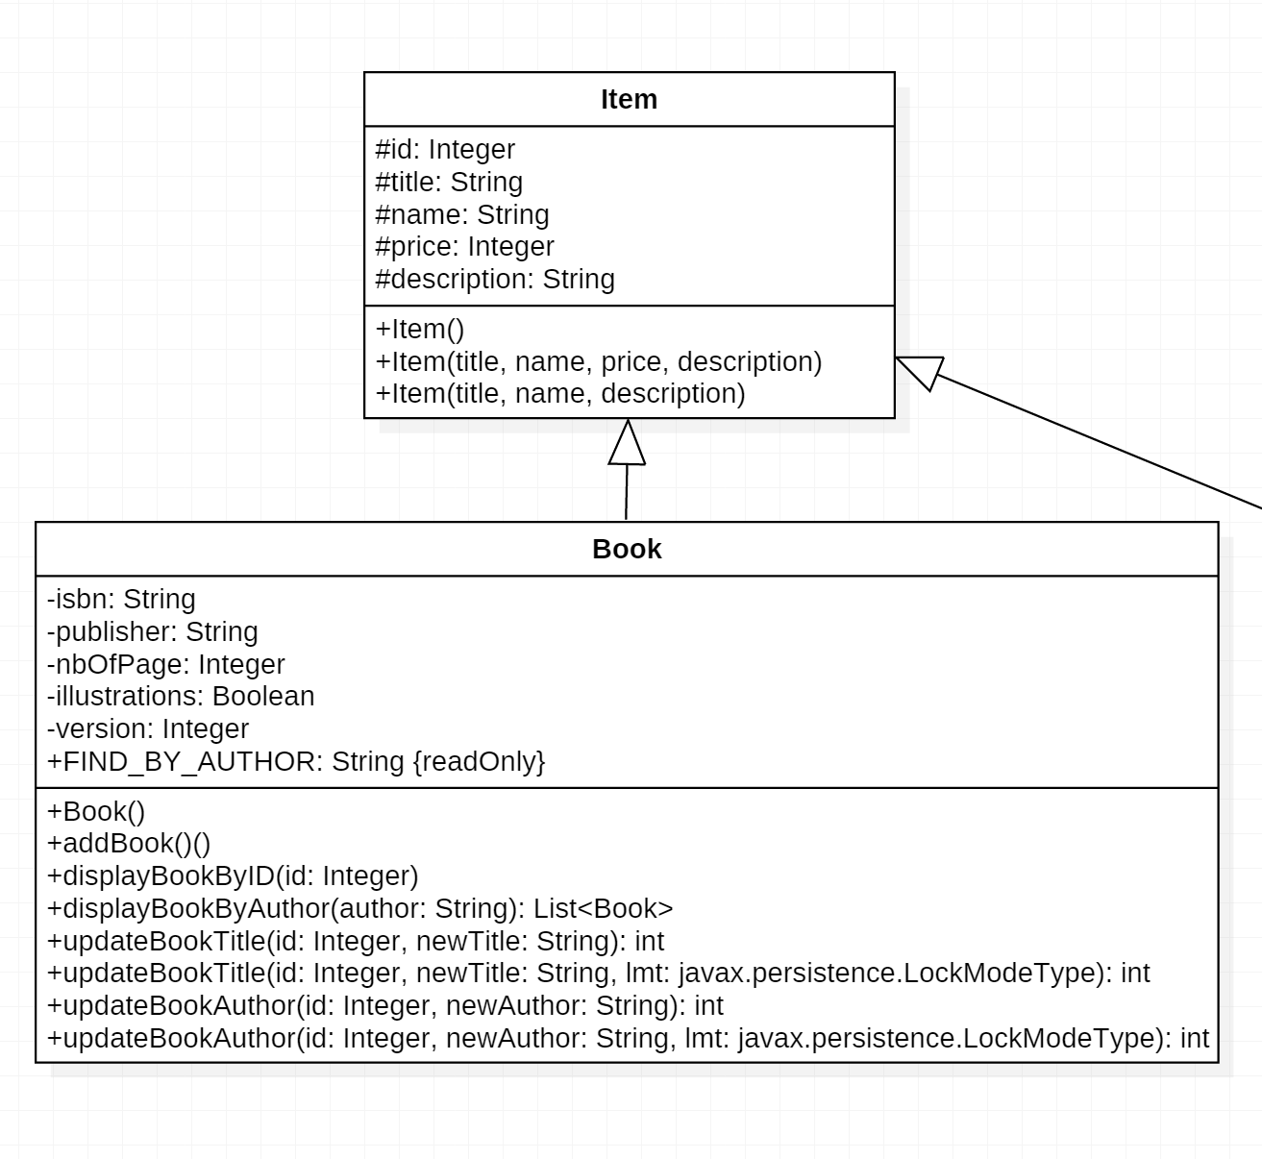
The Item / Book / CD / Track Model (1)

Slide 22
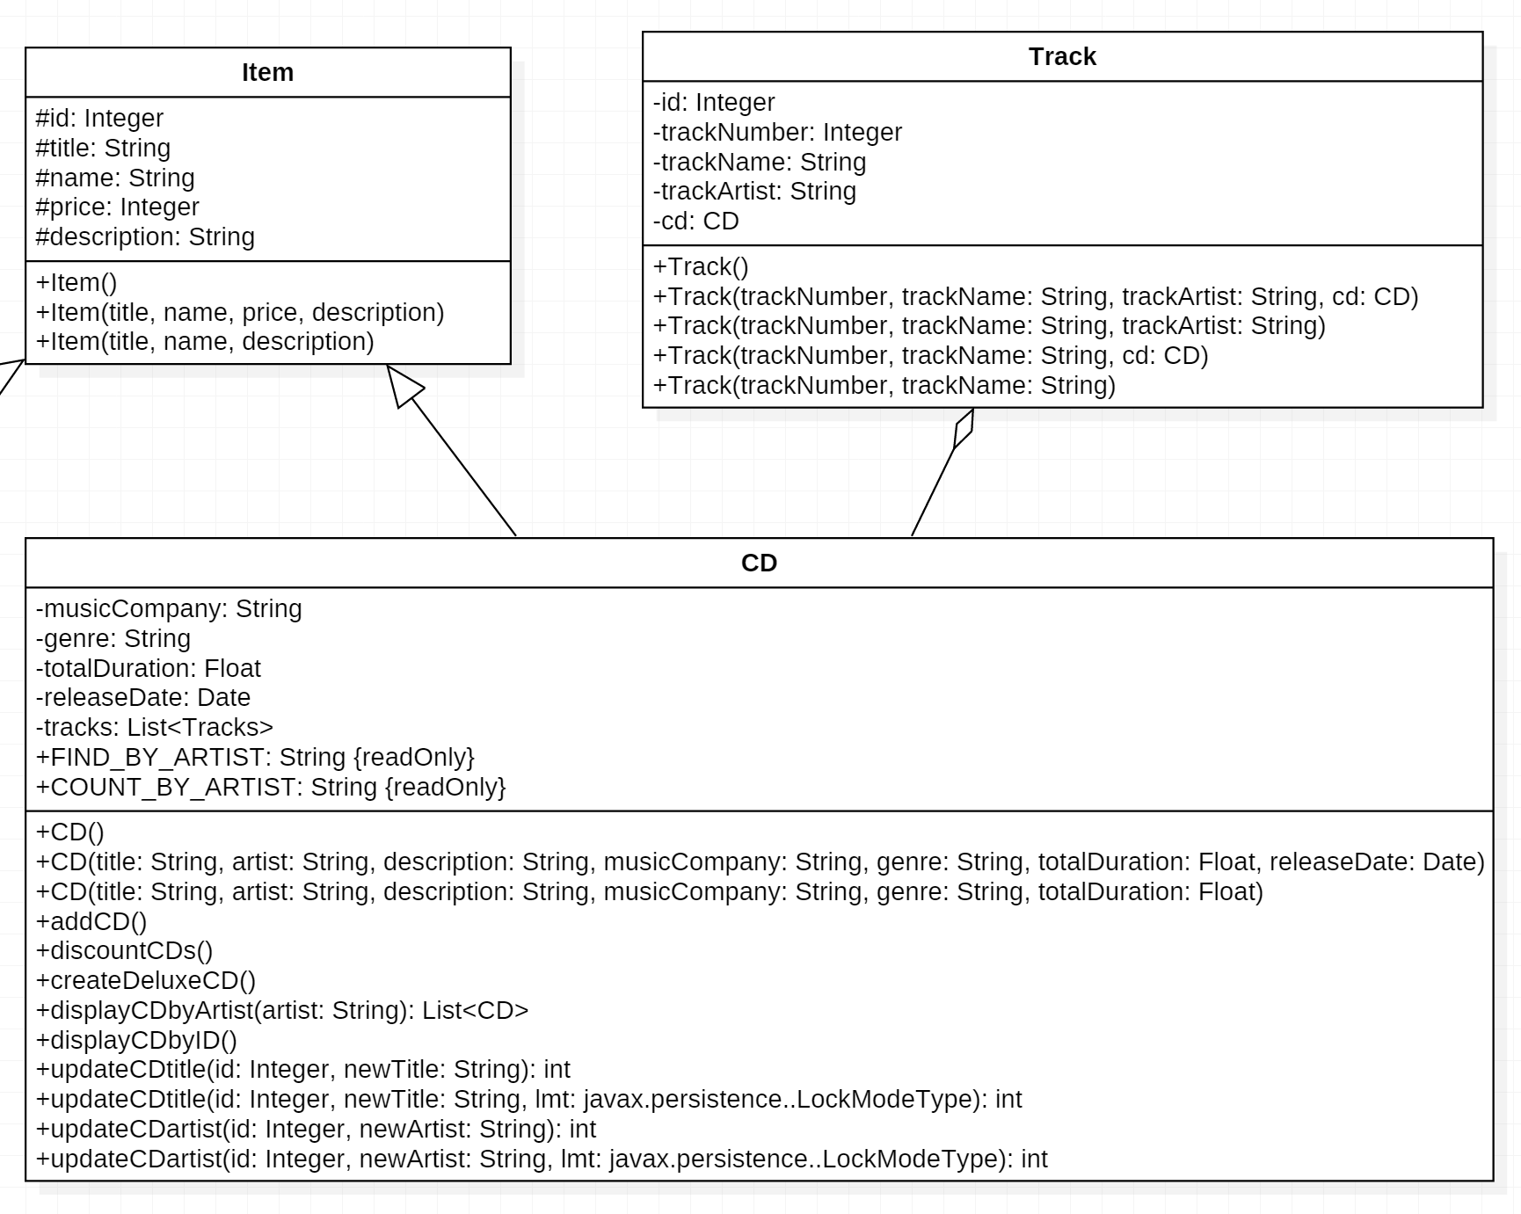
The Item / Book / CD / Track Model (2)

Slide 23
JPQL to Query Entities
Entity
Database Table
JPA can query entities using Java Persistence Query Language (JPQL)
SELECT b FROM Book b WHERE b.title like '%Java%'
Can be added to the Entity:

Slide 24
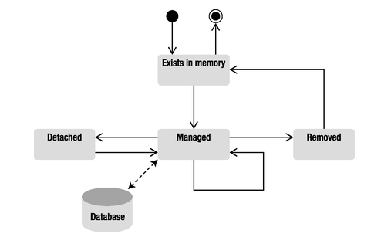
Entity Life Cycle
Creating an instance of Book causes the object to exist in memory, but JPA knows nothing about it.
Once managed by JPA's Entity Manager, it is mapped and synchronized with BOOK table.
EntityManager.remove() deletes the data from the database, but the Java object continues to exist in memory.

Slide 25
JPA Annotations in the Book Entity
@Entity informs the persistence provider that this class is an entity and that this persistence provider should manage it. (JPA itself cannot do persistence. It will need JPA Provider for persisting data into database.)
@Id defines the id attribute as being the primary key.
The @GeneratedValue annotation informs the persistence provider to autogenerate the primary key using the underlying database id utility.
The @Column annotation allows you to further define a database field, such as whether it is nullable and what its field length should be.
The @NamedQuery annotation defines a named query that uses JPQL to retrieve all the books from the database.

Slide 26
A simpler representation of Book.java [no inheritance] (1)
← bundles source code into package
package org.beginningee6.book.chapter02;
import javax.persistence.*;
@Entity
@NamedQuery(name = "findAllBooks", query = "SELECT b FROM Book b")
public class Book {
// ======================================
// = Attributes =
// ======================================
@Id
@GeneratedValue
private Long id;
@Column(nullable = false)
private String title;
private Float price;
@Column(length = 2000)
private String description;
private String isbn;
private Integer nbOfPage;
private Boolean illustrations;
← contains classes and interfaces for JPA
← JPA Annotation: "Book is an Entity"
← JPA Annotations here are used because the table will be created in the database and more instructions are needed beyond just datatype information:
- primary key - required fields - non-standard field length

Slide 27
A simpler representation of Book.java [no inheritance] (2)
// = Constructors =
// ======================================
public Book() {
}
public Book(String title, Float price, String description, String isbn, Integer nbOfPage, Boolean illustrations) {
this.title = title;
this.price = price;
this.description = description;
this.isbn = isbn;
this.nbOfPage = nbOfPage;
this.illustrations = illustrations;
}
// ======================================
// = Getters & Setters =
// ======================================
public String getTitle() {
return title;
}
public void setTitle(String title) {
this.title = title;
}

Slide 28
Driver.java (1)
package org.beginningee6.book.chapter02;
import javax.persistence.EntityManager;
import javax.persistence.EntityManagerFactory;
import javax.persistence.EntityTransaction;
import javax.persistence.Persistence;
← specific interfaces from the javax.persistence package
← the Persistence class
Package javax.persistence
Interface Summary
EntityManager | Interface used to interact with the persistence context.
EntityManagerFactory | Interface used to interact with the entity manager factory for the persistence unit.
EntityTransaction | Interface used to control transactions on resource-local entity managers.
Class Summary
Persistence | Bootstrap class that is used to obtain an EntityManagerFactory in Java SE environments.

Slide 29
Driver.java (2)
public static void AddHitchhiker() {
// Creates an instance of book
Book book = new Book();
book.setTitle("The Hitchhiker's Guide to the Galaxy");
book.setPrice(1250);
book.setDescription("Science fiction comedy series created by Douglas Adams.");
book.setIsbn("1-84023-742-2");
book.setNbOfPage(354);
book.setIllustrations(false);
`
// Gets an entity manager and a transaction
EntityManagerFactory emf = Persistence.createEntityManagerFactory("items");
EntityManager em = emf.createEntityManager();
// Persists the book to the database
EntityTransaction tx = em.getTransaction();
tx.begin();
em.persist(book);
tx.commit();
em.close();
emf.close();
}
}
"Items" is a  "persistence unit"
← Use the EntityManagerFactory to create an instance of an EntityManager
← EntityManager.persist() method commits the transaction. (Normally, exception handling would be needed here.)
← close to release resources

Slide 30
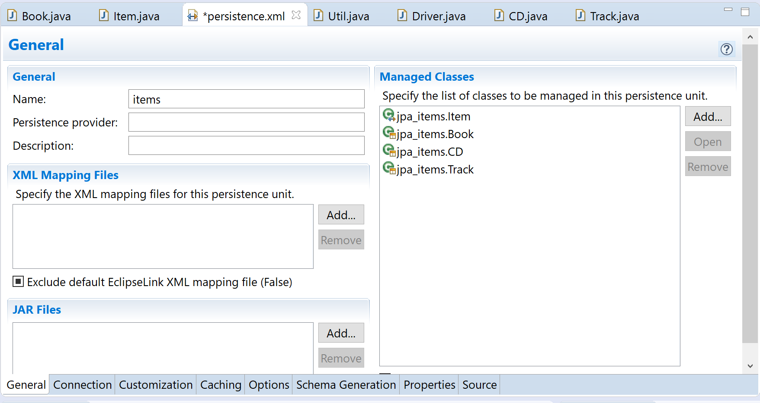
persistence.xml: Registering Entities
Classes containing Entities must be registered
Eclipse give you several tabs for easy editing of this file

Slide 31
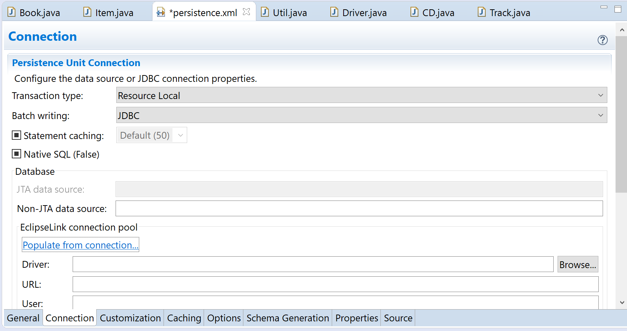
persistence.xml Creating the Connection Pool (1)
You can use your connection to populate persistence.xml

Slide 32
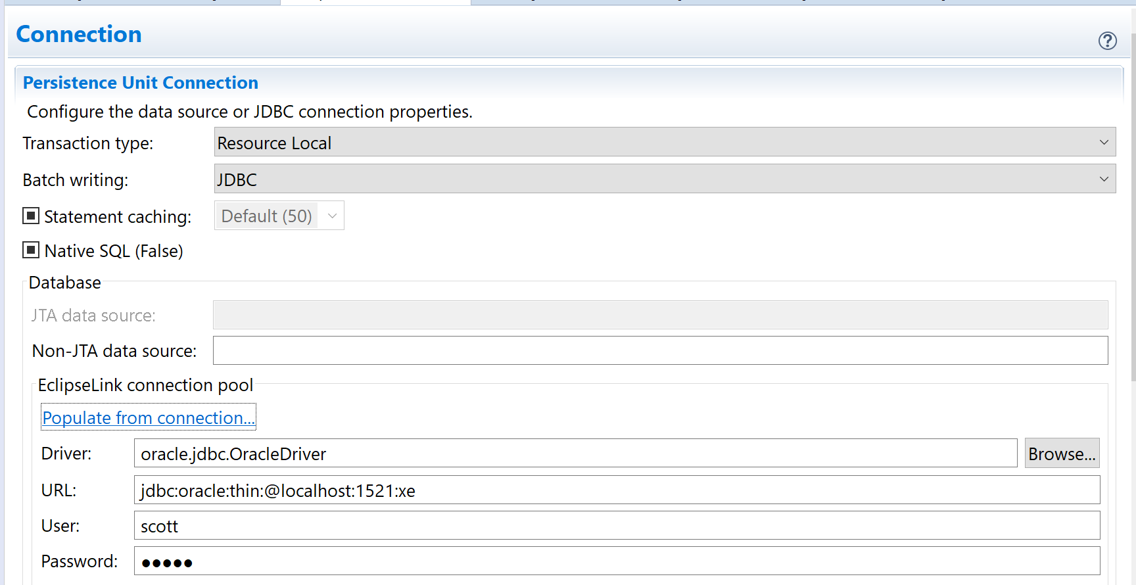
persistence.xml Creating the Connection Pool (2)
Eclipse give you several tabs for easy editing of this file

Slide 33
persistence.xml
<?xml version="1.0" encoding="UTF-8"?>
<persistence version="2.1" xmlns=http://xmlns.jcp.org/xml/ns/persistence xmlns:xsi=http://www.w3.org/2001/XMLSchema-instance xsi:schemaLocation="http://xmlns.jcp.org/xml/ns/persistence
http://xmlns.jcp.org/xml/ns/persistence/persistence_2_1.xsd">
<persistence-unit name="items" transaction-type="RESOURCE_LOCAL">
<provider>org.eclipse.persistence.jpa.PersistenceProvider</provider>
<class>jpa_items.Item</class>
<class>jpa_items.Book</class>
<class>jpa_items.CD</class>
<class>jpa_items.Track</class>
<properties>
<property name="eclipselink.jdbc.batch-writing" value="JDBC"/>
<property name="javax.persistence.jdbc.url" value="jdbc:oracle:thin:@localhost:1521:xe"/>
<property name="javax.persistence.jdbc.user" value="scott"/>
<property name="javax.persistence.jdbc.password" value="tiger"/>
<property name="javax.persistence.jdbc.driver"
value="oracle.jdbc.OracleDriver"/>
</properties>
</persistence-unit>
</persistence>
"items" persistence unit referenced in main
DB specific to
← your environment
This file abstracts the database settings from the Java code.

Slide 34
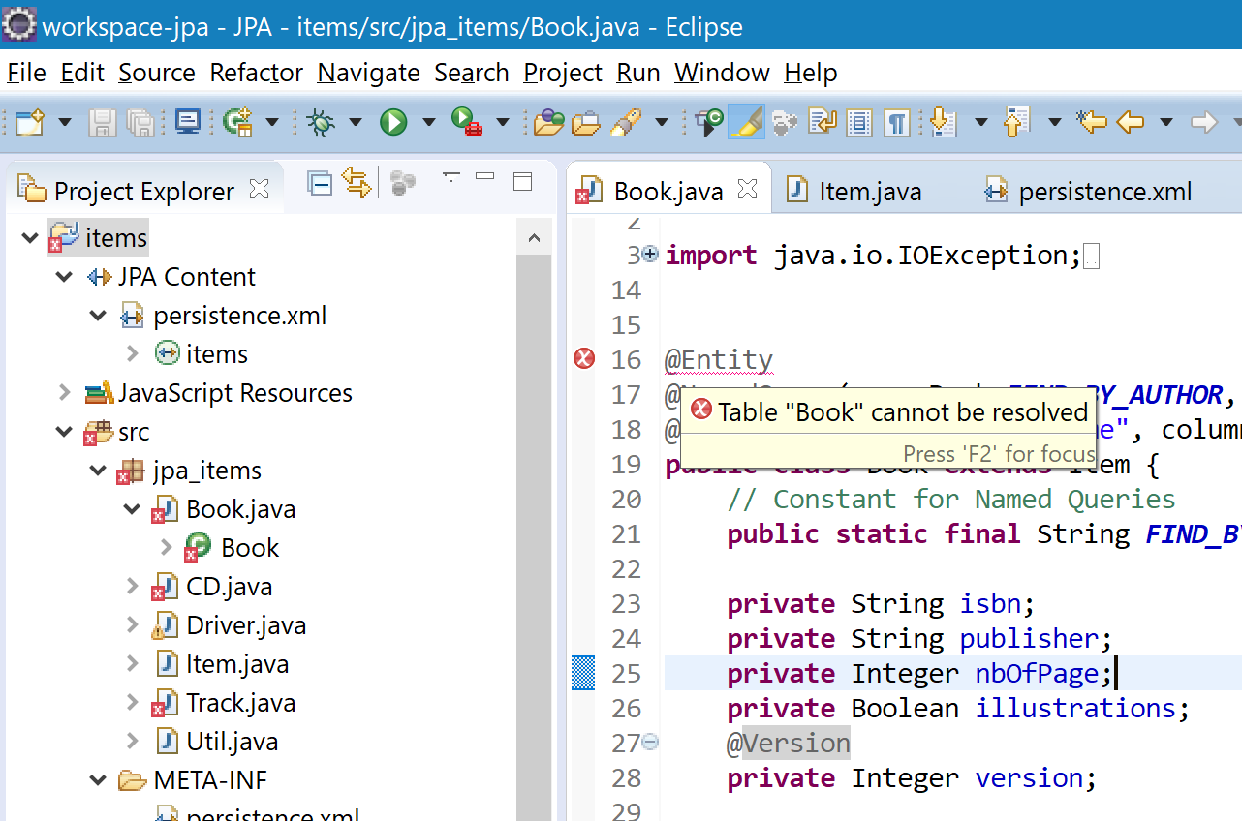
Building the Tables from Entities (1)
Note that there are errors for every Entity annotation
This is because the Entities are failing validation because JPA does not yet see them in the database
Solution?
In Eclipse, go to Window -> Preferences -> Validation, JP Validator, turn off for Build.

Slide 35
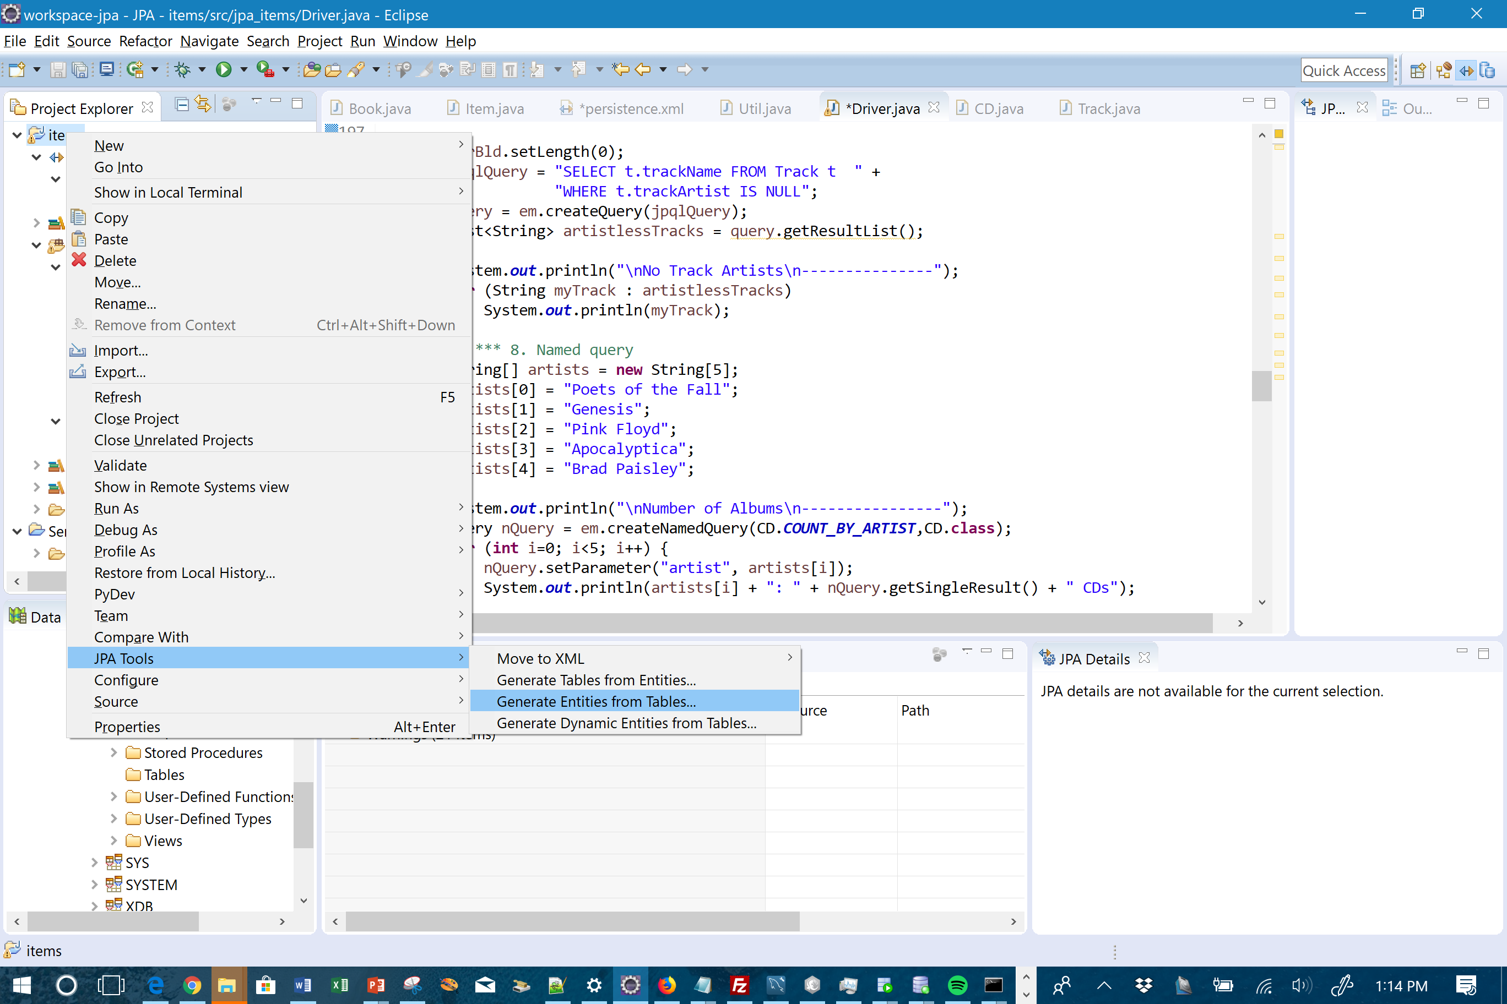
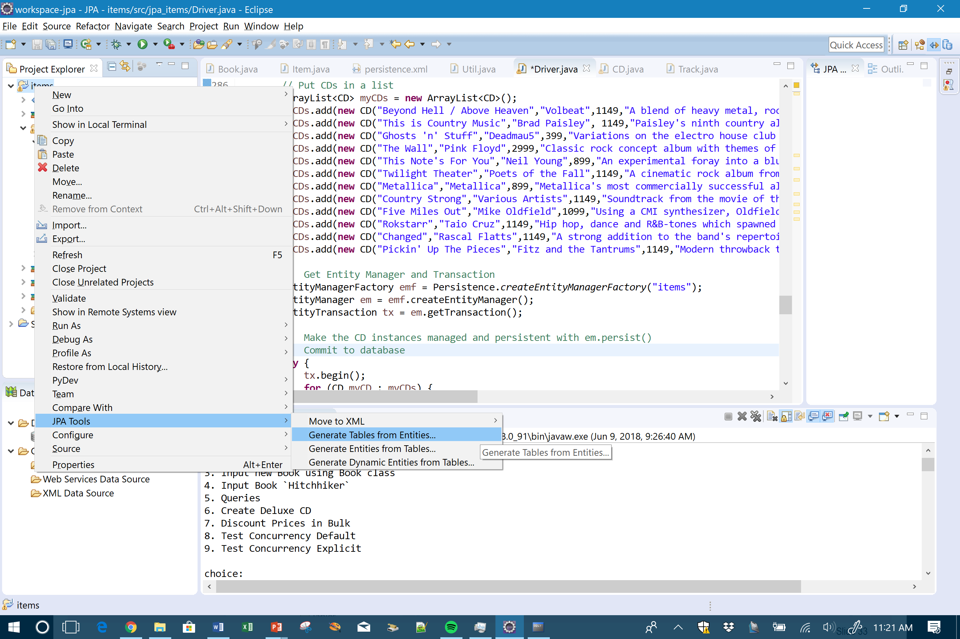
Building the Tables from Entities (2)
Right click your project and use JPA Tools

Slide 36
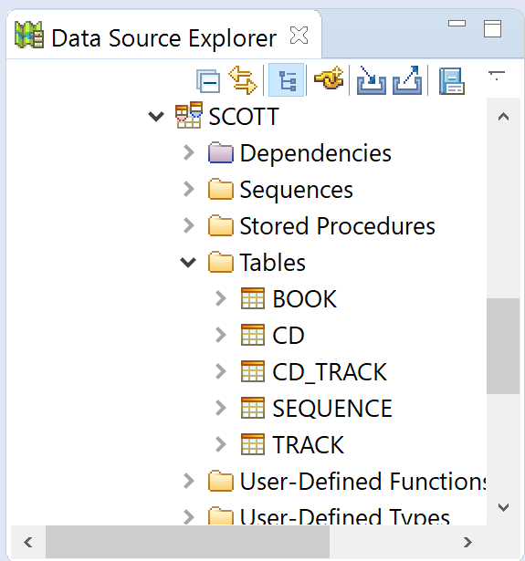
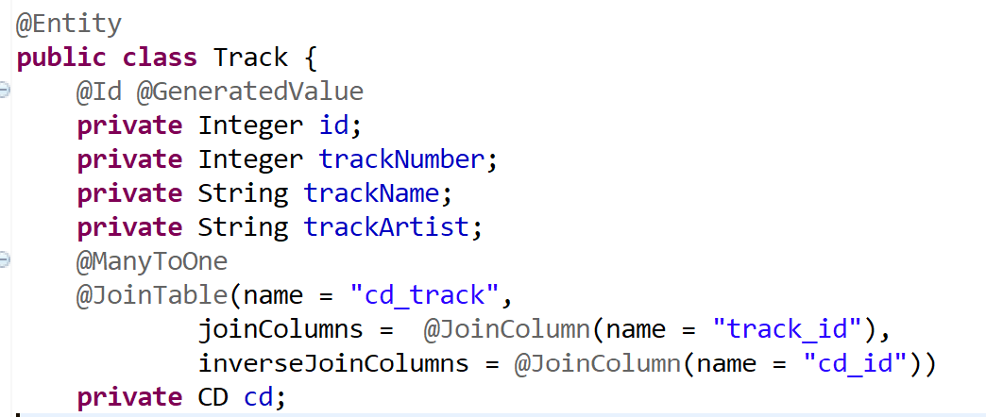
The results
Don't forget to go to back to Window -> Preferences -> Validation, JP Validator, turn back on for Build
Note: CD_TRACK bridging table came from the Track class

Slide 37

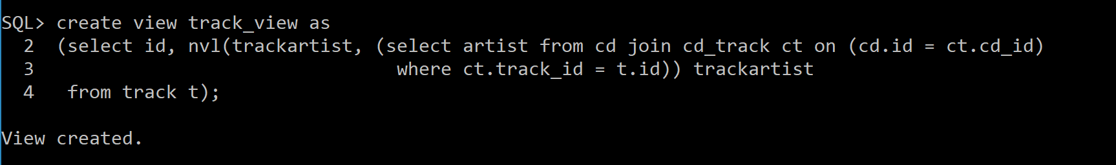
Handling artists at the CD level: Database View vs. JPA
If you want to create a view in scott/tiger, scott must have been granted the CREATE VIEW privilege by the DBA account
Or, this view could be approximated at the JPA level
// Tracks (like t) have CDs. And CD's have inherited name attribute (for CD artist)
jpqlQuery = "SELECT t.trackName, t.trackArtist, t.cd.name FROM Track t ORDER BY t.trackName";
query = em.createQuery(jpqlQuery);
List<Object[]> myTracks = query.getResultList();
System.out.println("\nTrack List\n----------");
for (Object[] myTrack : myTracks) {
System.out.print(myTrack[0] + " - ");
System.out.println( (myTrack[1]==null) ? myTrack[2] : myTrack[1]);
}

Slide 38
Persistence Object- Relational Mapping Part 1: Entities
Introduction to Mapping
Mapping Primary Keys  Simple
⬧ Composite
Mapping Other Attributes
Exploring JPA Annotations
Exploring XML Annotations

Slide 39
✓ Concept Check: Serializable Interface
Serializable Interface
An empty interface implemented by classes to enable object instances to be converted to a byte stream.
Serializable object may be written and read as a whole – to and from sources of output and input.
Serialization is the process of writing or reading an object to or from a persistent storage medium, such as a disk file
Whenever an object is serialized, Java store major and minor version information. This can be stored in a serialVersionUID field which can be hardcoded or produced by Java at runtime.
Object serialization provides the foundation for Java's remote method invocation (RMI) capabilities that enable Java programs that are distributed over a network to invoke each other's "remote methods."
RMI is used frequently in distributed enterprise applications built with Java.
At times, serialization will be a requirement for a particular object. But entities do not have to be serializable to be persisted in a database.

Slide 40
Conditions for Building an Entity
import javax.persistence.*;
@Entity
public class Book {
@Id
private Long id;
private String title;
private Float price;
private String description;
private String isbn;
private Integer nbOfPage;
private Boolean illustrations;
Entity class must
Be annotated with @Entity (or denoted in the XML descriptor as an entity)
Use @Id annotation to denote a simple primary key
Have a no-arg constructor that has to be public or protected. (may have other constructors)
Be a top-level class, not an inner class
Not be an enum or interface
Not be final. No methods or persistent instance variables of the entity class may be final.
Must implement the Serializable interface if an entity instance has to be passed by value as a detached object (e.g., through a remote interface)
JPA Identifiers from javax.persistence
@Entity indicates a persistent class
@Id defines unique identifier of object

Slide 41
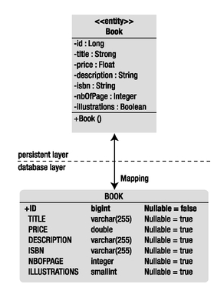
Mapping an Entity
Configuration by Exception
Unless otherwise specified, the container or provider should apply the default rules
Annotations are not required for the more common cases, only when override is needed.
Entity Name = Table Name
Attribute Name = Column Name
String → varchar (Oracle: varchar2)
Integer → integer (Oracle: number; SQL Server: int)
Long → bigint
Boolean → smallint
Default string size = 255

Slide 42
Customized Mapping
Mapping to a different table or one-to-many table mappings
@Entity
@Table(name = "tblBook")
public class Book {
@Entity
@SecondaryTables({
@SecondaryTable(name = "city"),
@SecondaryTable(name = "country")
})
public class Address {
@Id
private Long id;
private String street1;
private String street2;
@Column(table = "city")
private String city;
@Column(table = "city")
private String state;
@Column(table = "city")
private String zipcode;
@Column(table = "country")
private String country;
↑ Different DB tablename
By default, the attributes of the Address entity are mapped to the primary table called ADDRESS. The annotation @SecondaryTables informs you that there are two secondary tables: CITY and COUNTRY. You then need to specify which attribute is stored in which secondary table
→

Slide 43
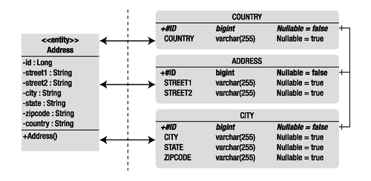
Mapping to Secondary Tables
When you use secondary tables, you must consider the issue of performance.
Every time you access an entity, the persistence provider accesses several tables and has to join them.
Secondary tables can be a good thing:
To obscure the DB complexity from users of the Entity
When you have expensive attributes such as binary large objects (BLOBs) that you want to isolate in a different table.

Slide 44
Primary Keys and How they Work in JPA
Primary keys must be unique and not null
Can consist of a single attribute (simple primary key) or multiple attributes (composite key)
Entities require a simple primary key
@GeneratedValue annotation indicates the key should be auto-generated
Sequence: uses a database SQL sequence
Identity: uses a database identity column
Table: instructs persistence provider to store sequence name and current value in a table, which is incremented after use
Auto: (default) lets the database determine which technique to use
public class Address {
@Id
@GeneratedValue(strategy = GenerationType.Sequence)
private Long id;

Slide 45
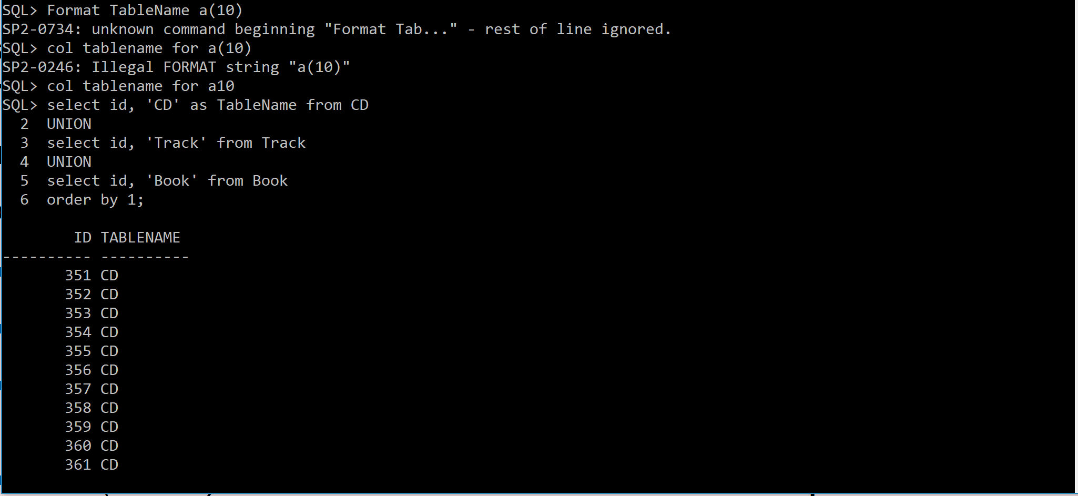

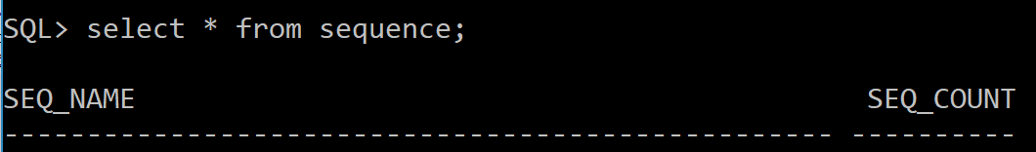
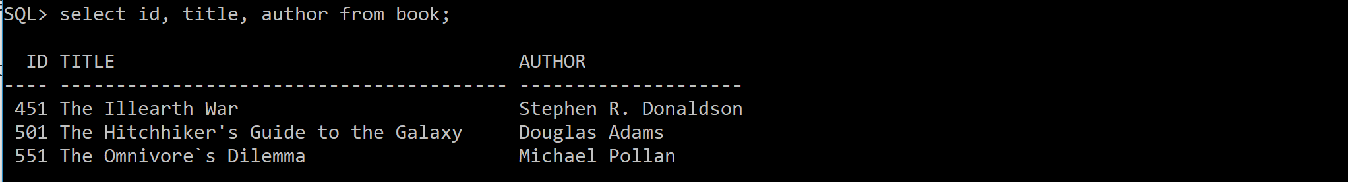
✓ Concept Check: Oracle Sequences
In Oracle, sequences control the uniqueness of simple, numeric primary keys.
You can have one or many sequences per schema.
Last number used (550) will be incremented for the next @GeneratedValue which happened to be used for a Book record.

Slide 46
Composite Primary Keys
Which I never recommend….
Can be mapped as well (See Appendix 1)

Slide 47
Mapping Other (non-key) Attributes
Many types of Java types can be mapped to databases:
Primitive types: int, double, float
Wrapper classes: Integer, Double, Float
Byte and Character arrays: byte[], Byte[], char[], Character[]
Strings: java.lang.String
Large numeric types: java.math.BigInteger, java.math.BigDecimal
Date/time types: java.util.Date, java.util.Calendar, java.sql.Date, java.sql.Time, java.sql.TimeStamp
Enumerated types and user-defined types that implement the Serializable interface
Collections of basic and embeddable types.

Slide 48
Important JPA Annotations
Annotation | Usage
@Basic | Overrides basic persistence. Has two parameters: fetch (LAZY or EAGER): data fetched eagerly on load, or lazily when asked for? optional (true or false): can value of attribute be null?
@Column | Defines column properties: name, size, unique?, nullable?, insertable?, editable?
@Lob | Attribute should be persisted to database as large object type
@Temporal | Defines a date/time field as DATE, TIME or TIMESTAMP
@Transient | Attribute should NOT be map to database, e.g., for calculated fields
@Enumerated | Attribute should be persisted as a enumerated type.
@Access | Explicitly states whether to use FIELD-based or PROPERTY-based access

Slide 49
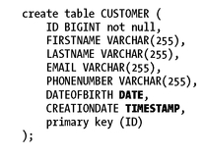
Example 1: A Customer
@Entity
public class Customer {
@Id
@GeneratedValue
private Long id;
private String firstName;
private String lastName;
private String email;
private String phoneNumber;
@Temporal(TemporalType.DATE)
private Date dateOfBirth;
@Temporal(TemporalType.TIMESTAMP)
private Date creationDate;
// Constructors, getters, setters
Sample translation to create table SQL.
Specific to database identified in persistence.xml
These mappings allows you to use java.util.Date and java.util.Calendar to store data and represent it as you would like in your application.

Slide 50

Example 2: A Track from an Album
id = 107
title = "Fake It"
duration = 3.233
description = "from 'Finding Beauty in Negative Spaces' by Seether"
@Entity
public class Track {
@Id
@GeneratedValue(strategy = GenerationType.AUTO)
private Long id;
@Column(name = "song_title", updatable = false)
private String title;
private Float duration;
@Basic(fetch = FetchType.LAZY)
@Lob
private byte[] wav;
@Column(nullable = false);
private String description;
// Constructors, getters, setters
Use a FetchType of LAZY as the large wav files will take significant time to load. Better to load them only when user clicks on a song to play the track.

Slide 51
JPA Annotations Operate at DB Level
Entity
Database Table
Suppose the ISBN field was set with annotation: @Column(updatable = false)
The Entity attribute could still change in memory, but it will not be synchronized with the database.
The generated SQL UPDATE command will not include the ISBN column

Slide 52
More JPA Annotations
Annotation | Usage
@ElementCollection | Defines a collection of instances of a basic type or embeddable class. Must be specified if collection is to be mapped via a collection table.
@CollectionTable | Allows you to customize details of the collection table (i.e., the table that will join the entity table with the basic types table) such as its name.
@MapKeyColumn | Specify the mapping for the key column of the map.

Slide 53
✓ Concept Check: Enumerations
Enumerated type definition consists of a wrapper that uses the word enum rather than class.
Enums are simply a list of variable names denoting the set of values that belong to this type. Assigned values in order (0, 1, 2, …)
public enum Commands {
// A value for each command
SUBMIT, CANCEL, HELP;
}
public enum CreditCardType {
// Credit cards supported by online store
VISA, MASTER_CARD, AMERICAN_EXPRESS;
}
VISA = 0;
MASTER_CARD = 1;
⬅ AMERICAN_EXPRESS = 2;

Slide 54
Working with Enumerations (2)
Default mapping of enum types is ORDINAL, corresponding to an integer
public enum CreditCardType {
// Credit cards supported by online store
VISA, MASTER_CARD, AMERICAN_EXPRESS;
}
@Entity
@Table(name = "credit_card")
public class CreditCard {
@Id
private String number;
private String expiryDate;
private Integer controlNumber;
@Enumerated(EnumType.STRING)
private CreditCardType creditCardType;
@Column(nullable = false);
// Constructors, getters, setters
Without the @Enumerated annotation, creditCardType would map to the database as the integer value.
Now, for example, "MASTER_CARD" would be persisted in database instead of the integer 1.

Slide 55
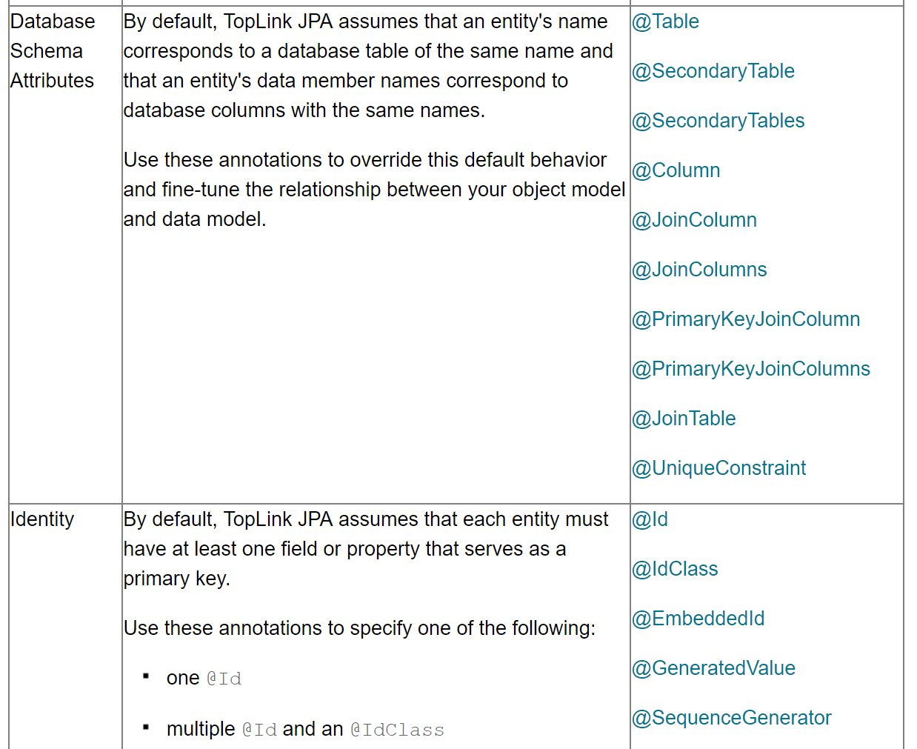
Full List of JPA Annotations
Available at: http://www.oracle.com/technetwork/middleware/ias/toplink-jpa-annotations-096251.html

Slide 56
✓ Concept Check: Fields versus Properties
@ public class Book {
private Long id;
private String title;
private Float price;
private String description;
private String isbn;
private Integer nbOfPage;
private Boolean illustrations;
public Long getId() {
return id;
}
public void setId(Long id) {
this.id = id;
}
public String getTitle() {
return title;
}
public void setTitle(String title) {
this.title = title;
}
← Object attributes are referred to as "fields" ← Fields which have getter and setter methods are referred to as "properties"

Slide 57
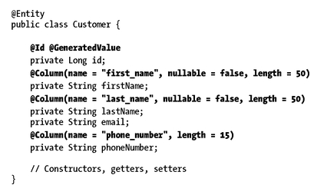
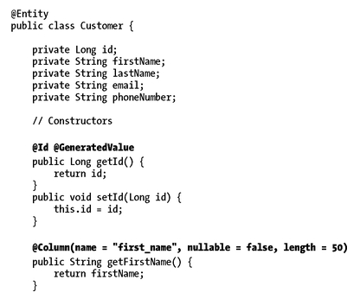
Two Ways to Annotate
↑ In the field declaration section of the class. field-based access
Before the "getters"
for each field. →
property-based access

Slide 58
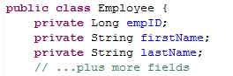
Are They Equivalent?
For the most part, yes.
However, getters and setters can be overridden by subclasses
Subclasses will not repeat the fields from the parent classes, so using property-based annotations might be needed
Getters may include logic that should not be executed at the time of loading an instance of your entity from the database
You cannot map a Java field to EMP_NAME
Java class splits EMP_NAME for more usability.
See next slide for how to accomplish this

Slide 59
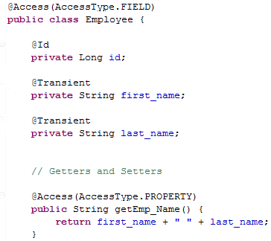
Explicitly Using @Access Notation
You cannot map a Java field to EMP_NAME
You can map a Java property to EMP_NAME
Putting annotations on methods forces JPA to access properties via methods.
It makes sense when internal state of your object differs from the database schema
Note use of @Transient annotation
Java class splits EMP_NAME for more usability.

Slide 60

Multi-Table Mappings with JPA (1)
Scenario:
Each book has a number of keywords or tags that Java would maintain in a list.
Field | Value
ID: | 801
Title: | A Storm of Swords
Price: | 8.99
Description: | Of the five contenders for power in Westeros, one is dead, another in disfavor, and still the wars rage as violently as ever.
ISBN: | 9780553573428
No. of Pages: | 1177
Illustrations: | Yes
Tags: | epic fantasy, game of thrones, HBO, battles, King's Landing…

Slide 61
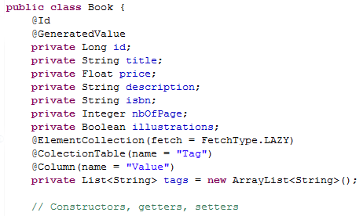
Multi-Table Mappings with JPA (2)
@ElementCollection annotation used to inform the persistence provider that the tags attribute is a list of strings and should be fetched lazily.
If @CollectionTable is missing, the table name defaults to BOOK_TAGS.
Concatenation of:
Entity name
underscore
attribute name
The @Column annotation to rename the column to VALUE
If not, the column would be named like the attribute, TAGS.

Slide 62
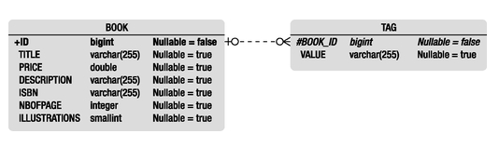
Creating Relational Structure in Database Using JPA
Database representation →
This Entity produces the table structure above.

Slide 63
✓ Concept Check: HashMaps
A Map is a collection of key/value pairs of objects.
Hashing: mapping a piece of data to a representative integer value
This integer hash can be used as an index into an array of key/value pairs
Map<String,String> countryNames = new HashMap<String,String>(200);
countryNames.put("FR", "France");
countryNames.put("GB", "Great Britain");
countryNames.put("IT", "Italy");
countryNames.put("VE", "Venezuela");
String name = countryNames.get("IT");
Keys must be unique, but values may be duplicated.
However, the HashMap class lets you use Strings as your key. The HashMap class:
Provides an implementation of the Map interface.
Uses a hash table to implement the Map interface.
Key | Value
FR | France
GB | Great Britain
IT | Italy
VE | Venezuela

Slide 64
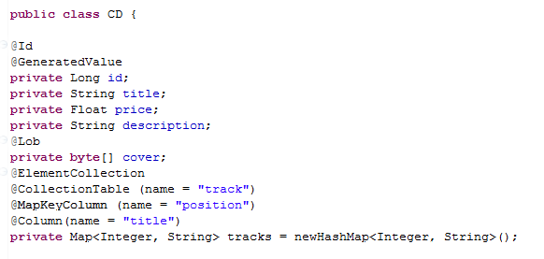
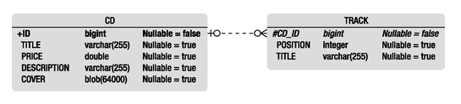
A JPA Example with a Map
@CollectionTable defines the database table name
@MapKeyColumn refers to the key column and lets you rename it from default naming convention - TRACK_KEY, in this case @Column annotation refers to the value column, here renamed "title"

Slide 65

XML Mapping
Every JPA Annotation has an XML equivalent
XML Deployment Descriptors are an alternative to JPA Annotations
XML Descriptors will override JPA Annotations
Advantage:
Separates the annotations from the Java code
But, it's purely a matter of taste

Slide 66
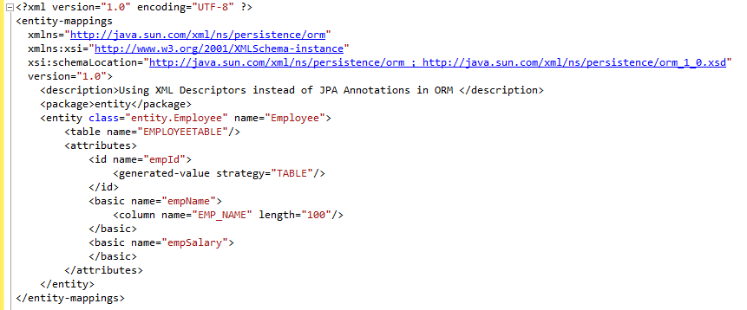
An Example XML file: Can you spot the Annotations?

Slide 67
Persistence Object- Relational Mapping Part 2: Relationships
Embeddables
Relationship Mapping
Inheritance Mapping

Slide 68
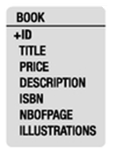
Review of Mapping Concepts (1)
So far, we have seen how to map:
Single Entities.
@Entity
public class Book {
@Id
private Long id;
private String title;
private Float price;
private String description;
private String isbn;
private Integer nbOfPage;
private Boolean illustrations;

Slide 69
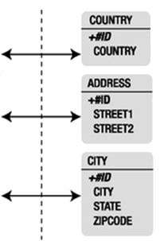
Review of Mapping Concepts (2)
And, we have seen how to map:
Secondary Tables
@Entity
@SecondaryTables({
@SecondaryTable(name = "city"),
@SecondaryTable(name = "country")
})
public class Address {
@Id
private Long id;
private String street1;
private String street2;
@Column(table = "city")
private String city;
@Column(table = "city")
private String state;
@Column(table = "city")
private String zipcode;
@Column(table = "country")
private String country;

Slide 70
Review of Mapping Concepts (3)
And you may have seen how to map embedded objects
Embeddables (in Appendix 1)

Slide 71
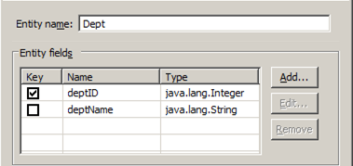
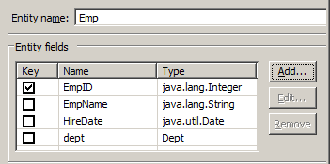
Databases vs. Objects
Databases map simple objects in a straight-forward fashion.
Mapping relationships is a bit more complex.
DATABASES
OBJECTS
EMP
EMP_ID
EMP_NAME HIRE_DATE
DEPT_ID
DEPT
DEPT_ID
DEPT_NAME

Slide 72
Databases vs. Objects
Tables
Relationships are managed via primary and foreign keys and JOIN operations.
Attribute values are obtained by SELECT statements.
Select d.dept_name from emp e, dept d where e.dept_id = d.dept_id and e.emp_id = 15
Entities
Relationships between instances of objects only available via class attributes.
Attribute values are obtained through object's GETTER methods.
EMP
EMP_ID
EMP_NAME HIRE_DATE
DEPT_ID
DEPT
DEPT_ID
DEPT_NAME
System.out.println (emp.getDept().getDeptName());

Slide 73
Databases vs. Objects
In a database, both tables are included in the JOIN statement.
Database query optimizers figure out which table is the "driving table."
Select d.dept_name from emp e, dept d where e.dept_id = d.dept_id and e.emp_id = 15
You travel from one entity to another
emp can use a method defined in dept, because the emp instance contains a class (Dept) as an attribute type.
EMP
EMP_ID
EMP_NAME HIRE_DATE
DEPT_ID
DEPT
DEPT_ID
DEPT_NAME
System.out.println (emp.getDept().getDeptName());

Slide 74
Relationships in Databases: Three Different Kinds of Cardinality
One-to-many - Each employee is in only one department. - Each department contains many employees
Many-to-many - A department may be located in many buildings. - Each building contains many departments
Acme Pharmaceuticals owns several buildings in different cities. They have several departments (such as IT) that are located in each building and head- quarters buildings that house members from each department. Acme offers its employees a direct-deposit payroll option.
One-to-one - Each employee has one bank account, - Each account is associated with only one employee
EMP
EMP_ID
EMP_NAME HIRE_DATE
DEPT_ID
DEPT
DEPT_ID
DEPT_NAME
EMP
EMP_ID
EMP_NAME HIRE_DATE
ACCT_ID
ACCOUNT
ACCT_ID
BANK_NAME
DEPT
DEPT_ID
DEPT_NAME
BLDG_DEPT
BLDG_ID
DEPT_ID
BUILDING
BLDG_ID
BLDG_NAME
CITY
join table

Slide 75
The Join Table
One-to-many → Many-to-many - Acme hires their first worker who splits time between two departments.
Many-to-many
Join tables are mandatory in many-to-many relationships, but optional in one-to-many and one-to-one.
CON: not fully normalized; extra table join needed
PRO: protects database from changing business rules
One-to-one → Many-to-many - Acme hires husband and wife who both direct deposit into the same account. - Acme now allows bonus to be deposited into separate account.
EMP
EMP_ID
EMP_NAME HIRE_DATE
EMP_DEPT
EMP_ID
DEPT_ID
DEPT
DEPT_ID
DEPT_NAME
join table
EMP
EMP_ID
EMP_NAME HIRE_DATE
EMP_ACCT
EMP_ID
ACCT_ID
ACCOUNT
ACCT_ID
BANK_NAME
DEPT
DEPT_ID
DEPT_NAME
BLDG_DEPT
BLDG_ID
DEPT_ID
BUILDING
BLDG_ID
BLDG_NAME
CITY
join table
join table

Slide 76
Databases vs. Objects
Ownership
In the normalized model, EMP is considered to own the relationship, as it stores the foreign key to DEPT.
In the Join Table model, neither EMP nor DEPT could be said to "own" the relationship.
Ownership
In the object model, Emp does own the relationship, because it includes entity Dept as one of its attributes.
Direction
Objects have the added concept of direction. Emp → Dept is "unidirectional"
EMP
EMP_ID
EMP_NAME HIRE_DATE
DEPT_ID
DEPT
DEPT_ID
DEPT_NAME
EMP
EMP_ID
EMP_NAME HIRE_DATE
EMP_DEPT
EMP_ID
DEPT_ID
DEPT
DEPT_ID
DEPT_NAME
join table

Slide 77
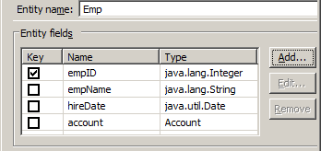
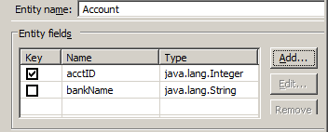
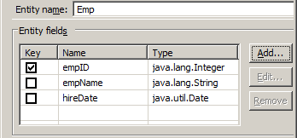

Object Relationships
One-to-One; unidirectional; Emp owns relationship
One-to-One; unidirectional; Account owns relationship
One-to-One; bidirectional; there is an owner and an inverse owner

Slide 78

How it Works
One-to-One; unidirectional; Emp owns relationship
@Entity
public class Emp {
@Id @GeneratedValue
@Column(name = "emp_id")
private Integer empID;
@Column(name = "emp_name")
private String empName;
@Column(name = "hire_date")
private Date hireDate;
@OneToOne
@JoinColumn(name = "acct_id")
private Account account;
Owner
@Entity
public class Account {
@Id @GeneratedValue
@Column(name = "acct_id")
private Integer acctID;
@Column(name = "bank_name")
private String bankName;
private Emp emp;

Slide 79
Owners and Inverse Owners
One-to-One; bidirectional; there is an owner and an inverse owner
@Entity
public class Emp {
@Id @GeneratedValue
@Column(name = "emp_id")
private Integer empID;
@Column(name = "emp_name")
private String empName;
@Column(name = "hire_date")
private Date hireDate;
@OneToOne
@JoinColumn(name = "acct_id")
private Account account;
Owner
@Entity
public class Account {
@Id @GeneratedValue
@Column(name = "acct_id")
private Integer acctID;
@Column(name = "bank_name")
private String bankName;
@OneToOne(mappedBy = "account")
private Emp emp;
Inverse Owner
mappedBy identifies the attribute that owns the relationship; required for bidirectional relationships.

Slide 80
Bidirectional Relationships Allow Queries from Both Sides
@Entity
public class Emp {
@Id @GeneratedValue
@Column(name = "emp_id")
private Integer empID;
@Column(name = "emp_name")
private String empName;
@Column(name = "hire_date")
private Date hireDate;
@OneToOne
@JoinColumn(name = "acct_id")
private Account account;
Owner
@Entity
public class Account {
@Id @GeneratedValue
@Column(name = "acct_id")
private Integer acctID;
@Column(name = "bank_name")
private String bankName;
@OneToOne(mappedBy = "account")
private Emp emp;
Inverse Owner
You can get the Bank Name from an employee.
You can get the Employee Name from an account.
System.out.println (emp.getAccount().getBankName());
System.out.println (account.getEmp().getEmpName());

Slide 81
Possible Combinations
Cardinality | Direction | Database Structure
One-to-One | Unidirectional | Foreign Key (either side) Join Table
One-to-One | Bidirectional | Foreign Key (either side) Join Table
One-to-Many | Unidirectional | Foreign Key (on the "One" side) Join Table
Many-to-One / One-to-Many | Bidirectional | Foreign Key (on the "One" side) Join Table
Many-to-One | Unidirectional | Foreign Key (on the "One" side) Join Table
Many-to-Many | Unidirectional | Join Table
Many-to-Many | Bidirectional | Join Table
* Default values marked in red.

Slide 82
JPA Annotations Used in Relationships
Annotation | Usage
@OneToOne @OneToMany @ManyToOne @ManyToMany | Identify the cardinality of the relationships cascade (optional) fetchType (optional). EAGER or LAZY mappedBy (required for ManyToMany & OneToMany; optional for OneToOne) the field that owns the relationship
@JoinTable | Allows control over the table name and column names of the Join Table joinColumns and inverseJoinColumns
@JoinColumn | Used to force database mapping to a foreign key method, rather than using a join table.
@OrderBy | Used for List attributes to specify which attribute(s) in the list should drive the sorting of the list. ASC or DESC can be added after each attribute name
@OrderColumn | Adds a column to the database table to keep track of the order of elements in a List, if no other attribute can maintain the order.

Slide 83

Example One
Bidirectional
One-to-One
Customer Entity owns the relationship
mappedBy points to the attribute in Customer that contains the Address.
@JoinColumn renames the foreign key

Slide 84


Example Two
One to Many (no annotation needed)
Unidirectional
Join Table by default
ORDER
ID
CREATIONDATE
ORDER_ORDER_LINE
ORDER_ID
ORDERLINES_ID
join table
ORDERLINE
ID
ITEM UNITPRICE
QUANTITY

Slide 85

Example Three
You can control the name of the Join Table and the names of its columns with the @JoinTable annotation.
The owner
The inverse owner

Slide 86

Example Four
@OrderBy uses the postedDate property of the Comment class to sort the posts in descending order.

Slide 87
Fetching Strategies
When you load an entity, you can fetch its relationships eagerly or lazily.
Ask yourself: "When I work with an entity, do I always need to see its related entity's data?"
Be mindful of performance. If all relationships are eager, you might end up fetching the entire relational schema!
Annotation | Default Fetching Strategy
@OneToOne | EAGER
@ManyToOne | EAGER
@OneToMany | LAZY
@ManyToMany | LAZY

Slide 88

Homework: "Lucy, Ricky, Ethel and Fred start a business"
Let's map several Entities and see the effects in the database!

Slide 89
Homework: Identify Modeling →
Cardinality: (1→M, etc.)
Direction: (uni or bi)
Join Table or Foreign Key
Answer these questions for each relationship
Relationship | Business Logic | Reporting Needs | How to Model?
Emp-Dept | An employee can only be in one department. Guaranteed! | Department Roster that displays in which buildings they can be found, and lists each department member. Employee status, including department and role. A list of all roles, and the current employees that occupy these roles. List of buildings that have dining services, and on which floors. Building report that shows which departments are resident No need to report on floors directly, as they have no context apart from their building.
Emp-Role | An employee can only have one role, but some think this could change in the distant future.
Dept-Bldg | A department can be located in several buildings. Many departments can share a building.
Bldg-Floor | A building has many floors.

Slide 90
Homework: Implement this data
Here is the complete set of your data
Build these classes with the appropriate JPA Annotations
Do not lose any of this data
Create a program to create Entities and persist the data in an Oracle database
Employee | Hire Date | Dept | Role
Lucy | 06-Aug-2010 | IT | Analyst
Ricky | 11-Dec-2012 | Sales | Admin
Fred | 01-Jun-1990 | IT | Manager
Ethel | 17-May-1997 | HR | Admin
Building | City | Depts | Floors
Chrysler | New York | IT, HR | 17th: 5 conf rooms, no dining facility 18th: 3 conf rooms, dining available 19th: no conf rooms, no dining facility
Pavilion | Camden | IT, Sales | Lobby: no conf rooms, dining facility

Slide 91

Inheritance
Inheritance is not implemented in relational databases.
So how is an object oriented structure interpreted?
Strategy | Implementation
Single table per class hierarchy (default) | The sum of the attributes of the entire entity hierarchy flattened to a single table.
Joined subclass strategy | Each entity in the hierarchy mapped to its own table.
Table per concrete class strategy | Each concrete entity hierarchy is mapped to its own table

Slide 92
✓ Concept Check: Concrete vs. Abstract Classes
Concrete Class
Will be annotated with @Entity.
Abstract Class
Also known as nonentity; will be used to provide structure only.
CONCRETE CLASS
A class that is designed to create instances.
ABSTRACT CLASS
A class that is not intended for creating instances. Its purpose is to serve as a superclass for other classes.

Slide 93



Inheritance Strategies
Note column DTYPE, known as a Discriminator
Table per concrete class
Joined subclass
Root Entity
key inherited by subclasses
Single table per class hierarchy

Slide 94
Comparison
Table per concrete class
Joined subclass
Single table per class hierarchy
Default
Wasted space, lots of blanks
Not normalized
Leaf node attributes (i.e., BOOK and CD) must be nullable
Joined subclass
Natural, object-oriented layout
All queries to leaf nodes require table joins with root entity
Performance issues
Table per Concrete Class
Denormalized
You can no longer join the tables. (If you want to display ITEMS, BOOKS, and CDs together, need to use the expensive UNION operation.
Single table per class hierarchy

Slide 95



Example of JOINED Inheritance
ITEM
CD
BOOK
@Entity
@PrimaryKeyJoinColumn(name = "cd_id", referencedColumnName = "id")
public class CD extends Item {
private String musicCompany;
private Integer numberOfCDs;
private Float totalDuration;
@Temporal(TemporalType.DATE)
private Date releaseDate;
@Entity
@Inheritance(strategy=InheritanceType.JOINED)
@DiscriminatorColumn(name = "ITEMTYPE")
public class Item {
@Id @GeneratedValue
protected Long id;
@Column(nullable = false)
protected String title;
protected Float price;
protected String description;

Slide 96
Example of TABLE_PER_CLASS Inheritance
CD
BOOK
ITEM
@Entity
@AttributeOverrides({
@AttributeOverride(name="id",
column = @Column(name="bookid")),
@AttributeOverride(name="title",
column = @Column(name="booktitle"))
})
public class Book extends Item {
private String isbn;
private String publisher;
private Integer nbOfPage;
private Boolean illustrations;
@Entity
@AttributeOverride(name="description", column=@Column(name="review"))
public class CD extends Item {
private String musicCompany;
private Integer numberOfCDs;
private Float totalDuration;
@Temporal(TemporalType.DATE)
private Date releaseDate;

Slide 97
Inheritance JPA Annotations
Annotation | Usage
@Inheritance | Sets the inheritance strategy. strategy equal to either: SINGLE_TABLE (default) JOINED TABLE_PER_CLASS
@DiscriminatorColumn | Used for SINGLE_TABLE and JOINED inheritance. Allows you to change the name and data type of the discriminator.
@DiscriminatorValue | Used for SINGLE_TABLE and JOINED inheritance. Allows you to change the value of the discriminator (default = entity name)
@PrimaryKeyJoinColumn | Used for JOINED inheritance to rename the specified key of a leaf node.
@AttributeOverride | Used for TABLE_PER_CLASS inheritance to rename an inherited attribute for a specified entity.
@MappedSuperClass | An annotation for a root class (instead of @Entity), but this class cannot be persisted to the database.

Slide 98
✓ Concept Check: Precision
Every penny counts. When storing money (or any other decimal value) as Float, you will notice that the precision in the database is not well preserved.
Increasing precision to use Double helps… but there are still precision issues if you are adding up a significant number of doubles due to rounding.
What to do for currency?
You could use BigDecimal, but you would be paying a memory and performance price for such precision.
Many developers store currency as Integer, but then store every value as cents, not dollars.

Slide 99
Persistence Managing Persistent Objects
Entity Manager
⬧ Query by Key
⬧ Internals
Cascading and Caching
JPQL Queries
Concurrency

Slide 100


Two Aspects of JPA
Mapping objects to a relational database
Querying these mapped objects.

Slide 101
Entity Manager Review (1)
package org.beginningee6.book.chapter04;
import java.text.ParseException;
import java.text.SimpleDateFormat;
import java.util.ArrayList;
import java.util.Random;
import javax.persistence.*;
public class Main {
public static void main(String[] args) throws ParseException {
SimpleDateFormat sdf = new SimpleDateFormat("dd-MMM-yyyy");
// Put CDs in a list
ArrayList<CD> myCDs = new ArrayList<CD>();
myCDs.add(new CD("Beyond Hell / Above Heaven","Volbeat", ...
myCDs.add(new CD("This is Country Music","Brad Paisley", ...
myCDs.add(new CD("Ghosts 'n' Stuff","Deadmau5", ...
myCDs.add(new CD("The Wall","Pink Floyd", ...
myCDs.add(new CD("Rokstarr","Taio Cruz", ...
myCDs.add(new CD("This Note's For You","Neil Young", ...
myCDs.add(new CD("Twilight Theater","Poets of the Fall", ...
myCDs.add(new CD("Five Miles Out","Mike Oldfield", ...
Create instances of twelve CDs and add them to a list which we can later commit to the database. Note: constructor calls are truncated and not all CDs are shown.

Slide 102
Entity Manager Review (2)
Create a factory for the persistence unit "chapter04"
// Get Entity Manager and Transaction
EntityManagerFactory emf = Persistence.createEntityManagerFactory("chapter04");
EntityManager em = emf.createEntityManager();
EntityTransaction tx = em.getTransaction();
// Make the CD instances managed and persistent with em.persist()
// Commit to database
try {
tx.begin();
for (CD myCD : myCDs) {
em.persist(myCD);
}
tx.commit();
}
catch(Exception e) {
System.out.println("\n *** Error committing to database. ***");
System.out.println(e.getMessage() + "\n");
}
Use the factory to create an entity manager.
Make the persistence provider aware that these entities are to be managed by the entity manager. All twelve CDs will be managed within transaction "tx"
The persistence unit from persistence.xml
<persistence-unit name="chapter04">
<class>org.beginningee6.book.chapter04.CD</class>

Slide 103
Querying by Key
// Find and output random result
Random generator = new Random();
Integer r = generator.nextInt(12) + 1;
CD randomCD = em.find(CD.class,r);
StringBuilder result = new StringBuilder();
result.append("\nA random CD: ");
result.append(randomCD.title).append( " by ");
result.append(randomCD.name).append("\n");
System.out.println(result);
// Close
em.close();
emf.close();
}
Use the entity manager to find a CD by its primary key.
(In this case, we know primary keys range from 1 to 12)
A random CD: Rokstarr by Taio Cruz

Slide 104
"Application-Managed" EntityManager
// Get Entity Manager and Transaction
EntityManagerFactory emf = Persistence.createEntityManagerFactory("chapter04");
EntityManager em = emf.createEntityManager();
EntityTransaction tx = em.getTransaction();
try {
tx.begin();
for (CD myCD : myCDs) {
em.persist(myCD);
}
tx.commit();
}
catch(Exception e) {
System.out.println("\n *** Commit Error ***");
System.out.println(e.getMessage() + "\n");
}
// Close
em.close();
emf.close();
The application is responsible for obtaining an instance of EntityManager and closing it out.
Unlike "container-managed" which uses Enterprise Java Beans (EJBs)

Slide 105
More on the Entity Manager
Manages entities
Creates, removes and updates entities in the database
Management occurs once the Entity Manager obtains a reference to an entity, for example in EntityManager.persist()
Until that point, the entity is considered to be "detached"
When detached, it will not synchronize its state against the database
Find entities by their primary key
Lock entities during concurrent updating: optimistically or pessimistically
Queries entities within a "persistence context"

Slide 106


Persistence Context (1)
Entity Manager stores entities in a persistence context.
Committing the Entity Transacation flushes the data to the database.
Persistence Context
A set of managed entity instances at a given time for a given user's transaction.
Amber 1. instantiates what will become CD 8 and CD 9
2. EntityManager.persist();
Entity
Manager
Persistence Context
(first-level cache)
 
3. EntityTransaction.commit();
Database

Slide 107
Persistence Context (2)
Sometimes you will need to persist new entities where the order of insertion is important.
New DEPT New EMP in this department DEPT record needs to be committed first, because EMP will store dept_id as foreign key.
GOOD NEWS: They can be persisted in any order; the Entity Manager handles transaction order for you.
Committing the Entity Transacation flushes the data to the database.
Amber 1. instantiates entities
2. EntityManager.persist();
Entity
Manager
Persistence Context
(first-level cache)
3. EntityTransaction.commit();
Database

Slide 108
Other EntityManager Methods
Method | Usage
getReference() | Retrieve a reference to an entity via the primary key, but not its data.
remove() | Deletes entity from the database, and detaches it from the EntityManager.
flush() | Sends data from EntityManager to database. (Not a commit, and not often needed, as tx.commit() will take care of flushing for you.)
refresh() | Overwrites the current state of a managed entity with data from the database.
contains() | Returns Boolean. Checks to see if entity is currently managed by EntityManager.
clear() | Clears the persistence context, making all entities detached
detach() | Detaches a particular entity
merge() | Reattaches a particular entiy.
JPA Element | Usage
orphanRemoval=true | When a database record is deleted, all other records in tables that store its primary key as a foreign key are deleted. (Only for @OneToOne or @OneToMany)

Slide 109
What Would Happen?
What would the City be in the database?
BUILDING
BLDG_ID
BLDG_NAME
CITY
chrysler.setCity("New York");
try {
tx.begin();
em.persist(chrysler);
em.persist(pavilion);
em.persist(seventeenth);
em.persist(eighteenth);
em.persist(nineteenth);
em.persist(lobby);
chrysler.setCity("Portland");
tx.commit();
}
em.persist() just made the entity chrysler known to the persistence context.
All changes are synchronized in cache until tx.commit(), which stores the entities in the database.
FLOOR
FLOOR_ID
FLOOR_NUMBER
CONF_ROOMS
DINING
BLDG_ID

Slide 110
What Would Happen?
What would the City be in the database?
em.clear() detached all entities, effectively removing them from the persistence context.
While the chrysler entity does have an updated city, it will not be committed to database.
BUILDING
BLDG_ID
BLDG_NAME
CITY
chrysler.setCity("New York");
try {
tx.begin();
em.persist(chrysler);
em.persist(pavilion);
tx.commit();
em.clear();
chrysler.setCity("Portland");
tx.begin();
tx.commit();
}
FLOOR
FLOOR_ID
FLOOR_NUMBER
CONF_ROOMS
DINING
BLDG_ID

Slide 111
What Would Happen?
What would the City be in the database?
BUILDING
BLDG_ID
BLDG_NAME
CITY
chrysler.setCity("New York");
try {
tx.begin();
em.persist(chrysler);
em.persist(pavilion);
tx.commit();
em.clear();
chrysler.setCity("Portland");
tx.begin();
em.remove(chrysler);
tx.commit();
}
FLOOR
FLOOR_ID
FLOOR_NUMBER
CONF_ROOMS
DINING
BLDG_ID
ERROR: Entity must be managed to call remove.

Slide 112
What Would Happen?
What would the City be in the database?
BUILDING
BLDG_ID
BLDG_NAME
CITY
chrysler.setCity("New York");
try {
tx.begin();
em.persist(chrysler);
em.persist(pavilion);
tx.commit();
em.clear();
chrysler.setCity("Portland");
tx.begin();
em.merge(chrysler);
tx.commit();
}
em.merge()
returned chrysler to Entity Manager control.
FLOOR
FLOOR_ID
FLOOR_NUMBER
CONF_ROOMS
DINING
BLDG_ID

Slide 113
What Would Happen?
What would the City be in the database?
BUILDING
BLDG_ID
BLDG_NAME
CITY
chrysler.setCity("New York");
try {
tx.begin();
em.persist(chrysler);
em.persist(pavilion);
tx.commit();
chrysler.setCity("Portland");
tx.begin();
tx.commit();
}
The entity chrysler never left the Entity Manager control, and the city is updated in the second transaction.
FLOOR
FLOOR_ID
FLOOR_NUMBER
CONF_ROOMS
DINING
BLDG_ID

Slide 114




Cascading Events (1)
try {
tx.begin();
em.persist(IT);
em.persist(HR);
em.persist(sales);
em.persist(lucy);
em.persist(ricky);
em.persist(fred);
em.persist(ethel);
em.persist(analyst);
em.persist(admin);
em.persist(manager);
tx.commit();
}
This code persists employees, departments and roles to the database.
However, you could cascade from EMP and save some extra persist() commands

Slide 115
Cascading Events (2)
@Entity
public class Emp {
@Id @GeneratedValue
private Integer emp_ID;
private String emp_Name;
@Temporal(TemporalType.DATE)
private Date hire_Date;
@ManyToOne(cascade=CascadeType.ALL)
@JoinColumn(name="dept_id")
private Dept dept;
@ManyToOne(cascade=CascadeType.ALL)
@JoinTable(joinColumns = @JoinColumn(name = "emp_id"),
inverseJoinColumns = @JoinColumn(name = "role_id"))
private Role role;
Now, you don't need to persist Depts or Roles.

Slide 116

Cascade Types
One or more of these can be added to any cardinality annotations except @ManyToMany.
CascadeType.PERSIST
CascadeType.REMOVE
CascadeType.MERGE
CascadeType.REFRESH
CascadeType.DETACH
CascadeType.ALL

Slide 117

Caching (1)
The first level cache is designed to cache short-lived entities and bundle transactions.
A second level cache exists to keep important data in memory to avoid constant transactions to the database.
The interface Cache can be used to check if object is in cache, or to remove object from cache. Not explicitly needed.
Amber
Bill
Entity
Manager
Entity
Manager
Persistence Context
(first-level cache)
 
 
Second Level Cache
  

Database
<persistence-unit name="chapter04PU"> <properties> <property name="javax.persistence.sharedCache.mode" value="ALL"/>
<property name="eclipselink.cache.size.default" value="2000"/> </properties>
</persistence-unit>

Slide 118
Caching (2)
javax.persistence.sharedCache.mode
ALL: All entities are cached.
ENABLE_SELECTIVE: Caching enabled only for entities annotated with @Cacheable(true)
eclipselink.cache.size.default
Sets the default number of Entities to be cached
eclipselink.cache.size.Emp
Would set number of Emps to cache
Amber
Bill
Entity
Manager
Entity
Manager
Persistence Context
(first-level cache)
 
 
Second Level Cache
  

Database
<persistence-unit name="chapter04PU"> <properties> <property name="javax.persistence.sharedCache.mode" value="ALL"/>
<property name="eclipselink.cache.size.default" value="2000"/> </properties>
</persistence-unit>

Slide 119
✓ Concept Check: SQL (1)
SELECT statements
SELECT t1.field1, t1.field2, t2.field3 FROM table1 t1, table2 t2 WHERE t1.foreign_key = t2.key AND t1.field4 = <value> ORDER BY t1.field1 ASC, t2.field DESC
SELECT d.dept_name, count(emp_id) FROM dept d, emp e WHERE d.dept_id = e.dept_id GROUP BY d.dept_name
SELECT p.product_type, sum(p.price * p.quantity) FROM product p GROUP BY p.product_type HAVING sum(p.price * p.quantity) > 1000;
← Field list, identified by table
← Table list with table aliases
← Where clause with conditions
← Sorting the results
← An example of a grouping query
↑ Having clause places restriction on the group operation

Slide 120
✓ Concept Check: SQL (2)
UPDATE statements
UPDATE table SET field1 = value1 field2 = value2 WHERE field3 = value3
INSERT statements
INSERT INTO table (field1, field2, field3) VALUES (value1, value2, value3...)
DELETE statements
DELETE FROM table WHERE field1 = value1
Subqueries
SELECT p1.product_name, p1.price FROM products p1 WHERE p1.price > (SELECT AVG(p2.price) from products p2)
← Table to be updated
← Fields with new values
← Where clause with conditions

Slide 121
✓ Concept Check: SQL (3)
Subqueries
SELECT p1.product_name, p1.price FROM products p1 WHERE p1.price > (SELECT AVG(p2.price) FROM products p2 WHERE p2.product_type='Warmer') AND p1.product_type='Warmer'
UPDATE products p SET p.price = .90 * p1.price WHERE p.product_id IN (SELECT ms.product_id FROM ms.monthly_specials WHERE ms.month = 'July')
SELECT CASE
SELECT p.product_name, CASE WHEN p.quantity > 0 THEN 'in stock' ELSE 'out of stock' END status FROM product p
"status" is a column alias for the results of the CASE statement.

Slide 122
Java Persistence Query Language (JPQL)
JPA defines JPQL as the way to query entities in a relational database.
JPQL is independent of the underlying database
JPQL Operations
SELECT, UPDATE, INSERT, DELETE
SQL returns rows and columns; JPQL returns lists of objects
JPQL uses object oriented notation
String jpqlQuery = "Select b from Building b";
Query query = em.createQuery(jpqlQuery);
List<Building> buildings = query.getResultList();
SQL
Query
Database
JPQL
JDBC calls

Slide 123
JPQL Select
SELECT: What to return from the database
Entity or List of Entities: Select b from Building b
Attribute or Collection of Attributes: - Select b.city from Building b - Select b.city from Building b where bldg_id=1
Multiple Attributes: Select b.bldg_id, b.city from Building b
Case Statements: Select CASE WHEN c.musicCompany='RCA' THEN (price-100) ELSE price END from CD c
New instances of an Entity or Entities: Select NEW org.beginningee.book.chapter04.CD(c.id, c.title...) from CD c

Slide 124

Querying for Entities
getResultList() -- returns a list of Objects
getSingleResult () -- returns single Object
You can also set a maximum number of results to retrieve with setMaxResults()
Return either an untyped list or untyped object, but you can cast
// *** Retrieve a list of entities
String jpqlQuery = "SELECT c from CD c";
Query query = em.createQuery(jpqlQuery);
List<CD> CDs = query.getResultList();
System.out.println("All CDs\n-------");
for (CD myCD : CDs)
System.out.println(myCD.title);
Placing the returned objects into a list of ← CDs, give us access to the CD properties and methods.

Slide 125

Querying for a Column
If you select only one column, you can cast to an appropriate data type class, in this case Integer.
// Retrieve a list of values
jpqlQuery = "SELECT DISTINCT c.price FROM CD c ORDER BY c.price";
query = em.createQuery(jpqlQuery);
List<Integer> prices = query.getResultList();
System.out. println("\nList Prices\n-----------");
for (int price : prices)
System.out. println((double)price / 100);
// Using primitive datatypes so that I can cast from int to double

Slide 126

Querying using CASE
// *** Retrieve list of values using SELECT CASE
strBld.setLength(0);
strBld.append("SELECT DISTINCT CASE WHEN c.musicCompany='RCA' ");
strBld.append(" THEN c.price - 100");
strBld.append(" ELSE c.price");
strBld.append(" END ");
strBld.append("FROM CD c");
jpqlQuery = strBld.toString();
query = em.createQuery(jpqlQuery);
List<Integer> dprices = query.getResultList();
System.out.println("\nDiscounted Prices\n----------------");
for (Integer dprice : dprices){
System.out.println((double)dprice / 100);
}

Slide 127
Selecting Multiple Values (1)
// *** Retrieve a list of multiple values
strBld.setLength(0);
strBld.append("SELECT c.title, c.name, c.releaseDate, c.totalDuration ");
strBld.append("FROM CD c WHERE c.genre='Rock'");
jpqlQuery = strBld.toString();
query = em.createQuery(jpqlQuery);
List<Object[]> rockCDs = query.getResultList();
System.out.println("\nRock CDs\n--------");
DateFormat df = DateFormat.getDateInstance(DateFormat.MEDIUM,Locale.US);
for (Object[] rockCD : rockCDs) {
System.out.print(padString(rockCD[0].toString(),25) + "\t");
System.out.print(padString(rockCD[1].toString(),20) + "\t");
System.out.print(df.format(rockCD[2]) + "\t");
System.out.println(rockCD[3] + " minutes");
}
0
1
2
3
Returns list of object arrays.
Selected columns become the elements of each array.

Slide 128

Selecting Multiple Values (2)
System.out.println("\nRock CDs\n--------");
DateFormat df = DateFormat.getDateInstance(DateFormat.MEDIUM,Locale.US);
for (Object[] rockCD : rockCDs) {
System.out.print(padString(rockCD[0].toString(),25) + "\t");
System.out.print(padString(rockCD[1].toString(),20) + "\t");
System.out.print(df.format(rockCD[2]) + "\t");
System.out.println(rockCD[3] + " minutes");
}

Slide 129
Try it yourself (or just refer to CD class on website)
Build an method in the CD class to create a Deluxe Version of a CD
Display all the CDs from which the user can choose. Include title & artist.
Use a SELECT statement to instantiate the new deluxe CD from the choice.
All information on the CD is the same, except for:
Release Date
Duration (prompt user for the number of extra minutes)
Price
Append " [Deluxe Edition]" to the CD title.
Select a CD to make a deluxe version of:
1. Beyond Hell / Above Heaven (Volbeat)
2. This is Country Music (Brad Paisley)
3. Ghosts 'n' Stuff (Deadmau5)
4. The Wall (Pink Floyd)
10. Rokstarr (Taio Cruz)
11. Changed (Rascal Flatts)
12. Pickin' Up The Pieces (Fitz and the Tantrums)
201. The Wall [Deluxe Edition] (Pink Floyd)
Enter CD number:
3
Enter release date (DD-Mon-YYYY):
12-Oct-2012
Enter number of extra minutes:
28.2
Enter new price for CD in pennies:
1499
Click for hint on user interface.

Slide 130
Solution (1)
public static void CreateDeluxeCD()
throws ParseException, IOException {
// Get Entity Manager and Transaction
EntityManagerFactory emf = Persistence.createEntityManagerFactory("chapter04");
EntityManager em = emf.createEntityManager();
EntityTransaction tx = em.getTransaction();
// Return list of object arrays
String jpqlQuery = "Select c.id, c.title, c.name from CD c order by c.id";
Query query = em.createQuery(jpqlQuery);
List<Object[]> cds = query.getResultList();
// Display CDs
System.out.println ("\nSelect a CD to make a deluxe version of:");
for (Object[] cd : cds)
System.out.println (cd[0] + ". " + cd[1] + " (" + cd[2] + ")");

Slide 131
Solution (2)
// Make a new CD from existing one
String cdNum = ConsoleInput("\nEnter CD number:");
StringBuilder jpql = new StringBuilder();
// Field order must match order of valid constructor
jpql.append ("Select NEW org.beginningee6.book.chapter04.CD");
jpql.append
("(c.title,c.name,c.description,c.musicCompany, c.genre,c.totalDuration)");
jpql.append ("from CD c where c.id=").append(cdNum);
query = em.createQuery(jpql.toString());
CD newCD = (CD) query.getSingleResult();

Slide 132
Solution (3)
// Prompt for new values
SimpleDateFormat sdf = new SimpleDateFormat("dd-MMM-yyyy");
String newDate = ConsoleInput ("\nEnter release date (DD-Mon-YYYY): ");
newCD.setReleaseDate(sdf.parse(newDate));
String extraMinutes = ConsoleInput ("\nEnter number of extra minutes: ");
Float extraMin = new Float(extraMinutes);
newCD.setTotalDuration(newCD.getTotalDuration() + extraMin);
String price = ConsoleInput ("\nEnter new price for CD in pennies: ");
newCD.price = Integer.parseInt(price);
newCD.title = newCD.title + (" [Deluxe Edition]");

Slide 133
Solution (4)
// Persist and commit new CD and close
tx.begin();
em.persist(newCD);
tx.commit();
em.close();
emf.close();
System.out.println(newCD.title + " stored.");
}

Slide 134
JPA WHERE clauses
Where clauses may contain the following operators:
=
>
>=
SELECT c.title, t.trackName FROM CD c, Track WHERE t.trackName like '%Home%' AND t MEMBER OF c.tracks
SELECT e.empName FROM Emp e WHERE e.dept.deptName IN ('IT','HR')
SELECT c.title FROM CD c WHERE c.tracks IS EMPTY
SELECT t.trackName FROM Track t WHERE t.trackArtist IS NULL
<
<=
<>
[NOT] BETWEEN
[NOT] LIKE
[NOT] IN
IS [NOT] NULL ← Is the value null?
IS [NOT] EMPTY ← Is the collection empty?
[NOT] MEMBER [OF]

Slide 135
More Useful Query Techniques
Parameter-driven Queries
SELECT b from Book WHERE b.title = :myTitle
:myTitle is referred to as a "named parameter," which will be replaced by the value of myTitle when the query is executed. String parameters will be enclosed in single quotes.
Parameters are set by the Query.setParameter() method query.setParameter("myTitle","War and Peace");
Bulk Operations
When you have a bulk update or delete operation, it is more efficient to use an UPDATE or a DELETE query, than to use methods on individual objects.

Slide 136
Typed Queries
Remember how we cast the result from query.getSingleResult() from object to CD?
We could have created a TypedQuery instead
Query query = em.createQuery(jpql.toString());
CD newCD = (CD) query.getSingleResult();
TypedQuery<CD> tQuery = em.createQuery(jpql.toString());
CD newCD = tQuery.getSingleResult();

Slide 137
Named Queries (refer to A simpler representation of Book.java [no inheritance] (1)
When we looked at the simple Book class, you might recall this annotation
You can list many named queries for an entity
These work much like other queries
@Entity
@NamedQuery(name = "findAllBooks", query = "SELECT b FROM Book b")
@Entity
@NamedQueries({
@NamedQuery(name = "findAllBooks", query = "SELECT b FROM Book b"),
@NamedQuery(name = "findBooksByAuthor",
query = "SELECT b FROM Book b WHERE b.author = :author")
})
Query query = em.createNamedQuery("findBooksByAuthor");
query.setParameter("author", "Isaac Asimov");

Slide 138

Best Practices for Named Queries
Create several named queries that can be defined at the entity level.
Include class name in the query name
You can create a CONSTANT in your class so that future developers will be able to see the queries in an IDE
@Entity
@NamedQuery(name = Customer.FIND_ALL_BY_STATE,
query = "SELECT c FROM Customer c WHERE c.state = :state")
public class Customer {
// Constants for queries
public static final String FIND_ALL_BY_STATE = "Customer.findAllByState";

Slide 139

Native Queries
When necessary, queries can be constructed natively.
You sacrifice database portablility, but there are times when it is useful
Use em.createNativeQuery

Slide 140
Concurrency concerns

Slide 141
Update CD Title
public static int updateCDtitle(Integer id, String newTitle) {
try {
EntityManagerFactory emf =
Persistence.createEntityManagerFactory("chapter04");
EntityManager em = emf.createEntityManager();
EntityTransaction tx = em.getTransaction();
// 1. CD is fetched from database before commit.
CD myCD = em.find(CD.class, id);
// Display time stamps
Date now = new Date();
System.out.println("\nRecord found by EM " + now);
CD.displayCDbyID(id);
// 2. Wait for user to confirm (bad coding, demonstrates concurrency)
Util.ConsoleInput("\nPress ENTER to confirm title change.");
// 3. CD is committed
tx.begin();
myCD.title = newTitle;
tx.commit();
// Display time stamps
now = new Date();
System.out.println("Record committed " + now);
CD.displayCDbyID(id); // ...more code follows
Long time between finding record and
committing it !!!

Slide 142


Bill vs. Cherise
Bill decides to edit a CD.
Cherise decides to edit the same CD.
142

Slide 143
Bill vs. Cherise The Referee
Time stamps
Note the em.refresh() to return the most recent state.
Otherwise, the Entity Manager could use a older, cached version of entity.
public static void displayCDbyID (Integer id) {
EntityManagerFactory emf = Persistence.createEntityManagerFactory("chapter04");
EntityManager em = emf.createEntityManager();
CD myCD = em.find(CD.class, id);
em.refresh(myCD);
Date now = new Date();
System.out.println("Current DB state: " + myCD.title + " by " + myCD.name + "\n" + now);
}
"The Ref"
143

Slide 144
Bill vs. Cherise Round One
Bill tries to update a CD title at the same time that
Cherise tries to update a CD artist for the same CD.
Bill commits first.
Who will win?

Slide 145


Bill vs. Cherise Round One
At 3:20, Bill and Cherise em.find() the object in an identical state.
☺
☺
Bill commits first, at 3:21 Artist change makes it to database.
Cherise commits second, at 3:22
Title change makes it to database.
Bill's author change still in database.
145

Slide 146
Bill vs. Cherise Round Two
Bill tries to update a CD title at the same time that
Cherise tries to update a CD title for the same CD.
Bill commits first.
Who will win?

Slide 147


Bill vs. Cherise Round Two
At 3:45, Bill and Cherise em.find() the object in an identical state.
☹
☺
Bill commits first, at 3:46 Title change makes it to database.
Cherise commits second, at 3:47
Cherise's title change overwrites Bill's.
147

Slide 148
Locking
JPA has two primary modes to lock database tables:
Optimistic locking 
Assumes most database transactions don’t conflict with other transactions.
Allows concurrency to be as permissive as possible when allowing transactions to execute.
Uses versioning
Pessimistic locking 
Assumes many database transactions might conflict with other transactions.
Lock is obtained on the resource before operating on it.
Locks can be obtained by these methods:
EntityManager.find(), EntityManager.refresh(), EntityManager.lock()
CD myCD = em.find(CD.class, id, LockModeType.OPTIMISTIC);

Slide 149
Types of Locks
LockModeType | Behavior | Requires Version Attribute?
READ | Deprecated, same as OPTIMISTIC | Yes
WRITE | Deprecated, same as OPTIMISTIC_FORCE_INCREMENT | Yes
OPTIMISTIC | . . . | Yes
OPTIMISTIC_FORCE_INCREMENT | . . . | Yes
PESSIMISTIC_READ | Forces serialization for display or update transactions. (You want to be sure the data is not being updated while you are reading it.) | No
PESSIMISTIC_WRITE | Forces serialization among update transactions. (Updates are not in parallel.) | No
PESSIMISTIC_FORCE_INCREMENT | . . . | Yes
NONE | No Locking | No

Slide 150
Bill vs. Cherise Round Three
Bill tries to update a CD title at the same time that
Cherise tries to update a CD title for the same CD.
Bill commits first, but is very slow.
Locking is set to PESSIMISTIC_WRITE.
Who will win?

Slide 151


"Slow" Bill vs. Cherise Round Three
At 10:00, Bill and Cherise both attempt a change.
Cherise is waiting for Bill to commit before she can em.find() the record.
☹
☺
Eventually, she times out.
Bill commits record at 10:03, but Cherise never even got to find the record.
151

Slide 152
Bill vs. Cherise Round Four
Bill tries to update a CD title at the same time that
Cherise tries to update a CD title for the same CD.
Bill commits first, but is very quick.
Locking is set to PESSIMISTIC_WRITE.
Who will win?

Slide 153


"Speedy" Bill vs. Cherise Round Four
Between 12:33 and 12:34, Bill and Cherise both attempt a change.
☹
Cherise is still waiting for Bill to commit before she can em.find(), but Bill is quick.
☺
Bill commits record at 12:34:01, then immediately after at 12:34:01, Cherise finds the record. However, note that she finds the record in the state in which Bill committed it.
By 12:34:04, Bill's version of the record is overwritten.
153

Slide 154
Pessimistic Locking
Pessimistic locking disadvantages:
Limits concurrent access to the data
Can cause bad scalability
May cause deadlocks
Better idea to implement without em.find(). You can create queries that perform a "SELECT FOR UPDATE NOWAIT" and add code to handle exceptions.
Optimistic locking is more widely implemented.

Slide 155
Optimistic Locks with Versions
LockModeType | Behavior | Requires Version Attribute?
OPTIMISTIC | Locking applied on transaction commit. Exception is thrown if it is found out that an display or update operation is operating on an old version of the data. | Yes
OPTIMISTIC_FORCE_INCREMENT | Locking applied on transaction commit. Exception is thrown if it is found out that an update operation is operating on an old version of the data. | Yes
PESSIMISTIC_READ | Forces serialization for display or update transactions. (You want to be sure the data is not being updated while you are reading it.) | No
PESSIMISTIC_WRITE | Forces serialization among update transactions. (Updates are not in parallel.) | No
PESSIMISTIC_FORCE_INCREMENT | Forces serialization for display or update transactions; updates version. | Yes
NONE | No Locking | No

Slide 156
Version Property
The Book Entity adds a @Version annotation for optimistic locking.
Version properties can be:
int, Integer, short, Short, long, Long, or Timestamp.
@Entity
@AttributeOverride(name="name", column=@Column(name="author"))
public class Book extends Item {
private String isbn;
private String publisher;
private Integer nbOfPage;
private Boolean illustrations;
@Version
private Integer version;

Slide 157
Bill vs. Cherise Round Five
Bill tries to update a Book title at the same time that
Cherise tries to update a Book title for the same Book.
The Book is versioned at 2.
Bill commits first, but is very quick.
Locking is set to OPTIMISTIC_FORCE_INCREMENT.
Who will win?

Slide 158

Bill vs. Cherise Round Five

Slide 159

Bill vs. Cherise Round Five

Slide 160
Exception Handling
Two ways to trap OptimisticLockExceptions:
When the data is flushed to the database:
EntityTransaction.commit()
EntityManager.flush(<object>)
When you explicitly try to get a lock
EntityManager.lock(<object>,<LockModeType>)

Slide 161
Persistence Callbacks and Listenters
Entity Manager
⬧ Query by Key
⬧ Internals
Cascading and Caching
JPQL Queries
Concurrency

Slide 162
Annotating Methods
So far, you have seen JPA annotations on:
Entities (e.g., @NamedQueries, @AttributeOverrides
Properties (e.g., @GeneratedValue, @Transient, @ Lob, @Column)
Methods can also be annotated.
In databases, triggers are routines that are fired when certain events occur, e.g. Post-Delete, Pre-Insert
In JPA, methods can also be triggered as an entity moves from one life cycle state to another.

Slide 163

The Entity Life Cycle
Let's review the Life Cycle
Annotation
@PrePersist
@PostPersist
Annotation
@PostRemove
@PreRemove
If entity was changed while detached.
Annotation
@PreUpdate
@PostUpdate
Annotation
@PostLoad

Slide 164
The Entity Life Cycle
Annotation | Description
@PrePersist | Marks a method to be invoked before EntityManager.persist() is executed.
@PostPersist | Marks a method to be invoked after the entity has been persisted. (If primary key autogenerated with @GeneratedValue, this value is available in the method.)
@PreUpdate | Marks a method to be invoked before a database update operation is performed. Either calling entity setters, or EntityManager.merge() method.
@PostUpdate | Marks a method to be invoked after a database update operation is performed.
@PreRemove | Marks a method to be invoked before Entity.Manager.remove() is executed.
@PostRemove | Marks a method to be invoked after the entity has been removed.
@PostLoad | Marks a method to be invoked after an entity is loaded -- either with JPQL query or EntityManager.find() – or refreshed from underlying database.

Slide 165
Callback Usage
@PrePersist and @PreUpdate methods on a class often validate the data.
@PostPersist and @PostUpdate methods can be created to clear the application cache, as the objects are no longer needed. Can also display success messages.
@PreRemove methods can be used to cascade deletion to other objects
@PostLoad can perform calculations (such as deriving age from date of birth) or trigger the loading of related data.

Slide 166
Rules for Callback Methods
Must not be static or final
One method may have multiple annotations (e.g., @PrePersist and @PreUpdate), but an annotation can only be applied to a single method for a class
Can invoke JNDI, JDBC, JMS and EJBs, but not any EntityManager or Query Operations.
Superclass methods are invoked first (e.g., Item @PrePersist will run before CD @PrePersist)
If you are using cascading, cascaded callback methods will also be invoked. For instance using @PreRemove
Callback methods can only throw RuntimeExceptions, not any checked exceptions like IOException, SQLException, DataAccessException.

Slide 167
Try it Out
Run the Driver callbacksAndListeners on the web
Examine the code for the various Emp methods and trace the callback methods.

Slide 168
Listeners
An entity listener is a POJO (Plain old Java Object) which has methods annotated like the callback methods
Listeners can be used for multiple classes, unlike callbacks
@EntityListeners({ListenerClass1.class, ListenerClass2.class})
CALLBACK
A user-defined method that is invoked automatically by JPA when a life-cycle event occurs.
LISTENER
A stateless class which defines one or more callback methods.

Slide 169
Rules for Listener Class
Class must have a public, no-argument constructor.
Method needs to have access to the entity state
Methods may have a signature that takes an Entity as an argument, or an Object.
Entity arguments may be of a superclass type or a leaf node
A superclass or Object argument needed if the listener is to work on multiple entities.

Slide 170
Default Listeners
A default listener for all classes can be established in persistence.xml
This saves you the trouble of annotating every class.
It must be enclosed in the <persistence-unit-metadata> tag, which is used for all metadata that does not have a JPA annotation equivalent.
Default listeners can be excluded from listening to an entity using the @ExcludeDefaultListeners annotation.
<persistence-unit-metadata>
<persistence-unit-defaults>
<entity-listeners>
<entity-listener class="callbacksAndListeners.Listener"/>
</entity-listeners>
</persistence-unit-defaults>
</persistence-unit-metadata>

Slide 171

Setting up an Audit Trail using JPA Listeners and Callbacks
Look at the code under callbacksAndListeners

Slide 172
Hints
You need to create an Entity for the audit table.
Properties id and name from the superclass can be used for columns ROWKEY and ROWDESCRIPTION.
The table name can be derived from the class.
The user id can be obtained from System.getProperty("user.name"))
Create a method in the audit trail entity to persist the audit trail information.

Slide 173
Listeners.java
package callbacksAndListeers;
import java.util.Date;
import javax.persistence.*;
public class Listeners {
@PostPersist
void onPostPersist(AuditedObject obj) {
AuditTrail audit = new AuditTrail();
String strClass = obj.getClass().toString();
audit.log(obj.id,obj.name,
strClass.substring(strClass.lastIndexOf(".")+1), "Insert");
}
@PostUpdate
void onPostUpdate(AuditedObject obj) {
AuditTrail audit = new AuditTrail();
String strClass = obj.getClass().toString();
audit.log(obj.id,obj.name,
strClass.substring(strClass.lastIndexOf(".")+1), "Update");
}
@PostRemove
void onPostRemove(AuditedObject obj) {
AuditTrail audit = new AuditTrail();
String strClass = obj.getClass().toString();
audit.log(obj.id,obj.name,
strClass.substring(strClass.lastIndexOf(".")+1), "Delete");
}
}

Slide 174
AuditTrail.java (1)
package org.beginningee6.book.chapter05;
import java.lang.Integer;
import java.lang.Long;
import java.lang.String;
import java.util.Date;
import javax.persistence.*;
@Entity
public class AuditTrail {
@Id @GeneratedValue
private Long id;
private String tablename;
private Integer rowKey;
private String rowDescription;
private String rowOperation;
@Temporal(TemporalType.TIMESTAMP)
private Date transactionDate;
private String userid;

Slide 175
AuditTrail.java (2)
// AuditTrail methods
public void log(Integer id, String desc, String myClass, String operation) {
EntityManagerFactory emf = Persistence.createEntityManagerFactory("chapter04");
EntityManager em = emf.createEntityManager();
AuditTrail audit = new AuditTrail();
audit.setTable(myClass);
audit.setRowOperation(operation);
audit.setTransactionDate(new Date());
audit.setUserid(System.getProperty("user.name"));
audit.setRowKey(id);
audit.setRowDescription(desc);
EntityTransaction tx = em.getTransaction();
tx.begin();
em.persist(audit);
tx.commit();
em.close();
emf.close();
}

Slide 176
Product.java
package org.beginningee6.book.chapter05;
import java.lang.Integer;
import java.lang.String;
import javax.persistence.*;
@EntityListeners(Listeners.class)
@Entity
public class Product extends AuditedObject {

Slide 177
Appendix 1 JPA when there is a composite primary key

Slide 178
Composite Keys and JPA (Method #1)
A primary key class must be defined to represent the composite key →
Now the JPA annotation @EmbeddedID is used to identify the primary key
Every @EmbeddedId must refer to an embeddable class marked with @Embeddable
@Embeddable public class ContractPK implements Serializable { @Column(name = "CONTRACT_YEAR", nullable = false) private Integer contract_year; @Column(name = "RECORD_NUMBER", nullable = false) private Integer record_number;
@Entity public class Contract implements Serializable { @EmbeddedID private ContractPK contractPK;
Classes must also implement Serializable if they need to cross architectural layers (e.g., they will be managed in the persistent layer and used in the presentation layer)

Slide 179
Embeddable Classes
Embeddable classes require:
a no-arg constructor
getters and setters
equals() implementation
hashCode() implementation
Implementation of the Serializable interface
Embedded classes have no @Id annotation
@Embeddable public class ContractPK implements Serializable { @Column(name = "CONTRACT_YEAR", nullable = false) private Integer contract_year; @Column(name = "RECORD_NUMBER", nullable = false) private Integer record_number;

Slide 180
✓ Concept Check: equals()
An object's default equals() method tests for reference equality only.
Either two different variables refer to same object -or-
An object variable has been assigned to another object variable
You need to override the method to check for content equality.
(obj instanceof ContractPK) checks to see if obj is derived from class ContractPK ← or any of its subclasses.
@Override
public boolean equals(Object obj) {
if (this == obj)
return true; // Reference equality
if (!(obj instanceof ContractPK))
return false; // Objects not same type
// Content equality: compare fields (elements of the primary key)
// If both fields are equal, return true
ContractPK pk = (ContractPK) obj;
return contract.year.equals(pk.contract_year) &&
record_number.equals(pk.record_number);
}
Notes:
Consider using this method in code.
Book book = new Book();
book.setTitle("War and Peace");
if (book.equals(book)) System.out.println "Reference equality observed.";
How does this work?
book.equals() tells us to use the method defined in distinct object "book"
But then we pass the exact same object to book's equals method!
Inside the method, "this" refers to book.equals(book)….or the object that is being currently used!
Inside the method, "obj" refers to book.equals(book)… the parameter being passed.
Since the object being passed is equal to the object being invoked, we return true.

Slide 181
equals() Behaviour
public class EqualityTest {
public static void main(String[] args) {
// ContractPK overrides equals method for content equality
ContractPK pk1 = new ContractPK(2012,50123);
ContractPK pk2 = new ContractPK(2012,50123);
DocumentPK pk3 = new DocumentPK(2012,50123);
DocumentPK pk4 = new DocumentPK(2012,50123);
System.out.println("Using ContractPK, (pk1=pk1?): " + pk1.equals(pk1));
System.out.println("Using ContractPK, (pk1=pk2?): " + pk1.equals(pk2));
System.out.println("Using ContractPK, (pk1=pk3?): " + pk1.equals(pk3));
System.out.println();
System.out.println("Using DocumentPK, (pk4=pk2?): " + pk4.equals(pk2));
System.out.println("Using DocumentPK, (pk4=pk3?): " + pk4.equals(pk3));
System.out.println("Using DocumentPK, (pk4=pk4?): " + pk4.equals(pk4));
}
}
Two independent classes:
DocumentPK uses default method.
ContractPK
overrides equals method.
Using ContractPK, (pk1=pk1?): true
Using ContractPK, (pk1=pk2?): true
Using ContractPK, (pk1=pk3?): false
Using DocumentPK, (pk4=pk2?): false
Using DocumentPK, (pk4=pk3?): false
Using DocumentPK, (pk4=pk4?): true
Reference equality
Content equality (same obj type and key values)
Inequality (key fields and values same, but diff obj type)
Inequality (key fields and values same, but diff obj type)
Content equality (same obj type and key values)
Reference equality

Slide 182
✓ Concept Check: hashCode()
The hashCode method is used by data structures such as HashMap and HashSet to provide efficient placement and lookup of these objects in these collections.
Whenever the equals method is overridden, the hasCode method should also be overridden.
hashCode() can be automatically generated using most Java IDEs. (like getters and setters)
@Override
public int hashCode() {
final int prime = 31;
int result = 1;
result = prime * result
+ ((record_number == null) ? 0 : record_number.hashCode());
result = prime * result + ((year == null) ? 0 : year.hashCode());
return result;
}

Slide 183
Main.java
package org.beginningee6.book.chapter03;
import javax.persistence.*;
public class Main {
public static void main(String[] args) {
// Create entities
ContractPK contractPK = new ContractPK(2012,32148);
Contract contract = new Contract(contractPK, "Acme University and Ken Wu", ""); contract.setContractDescription("To teach Java EE class");
// Get an entity manager and a transaction
EntityManagerFactory emf = Persistence.createEntityManagerFactory("chapter03");
EntityManager em = emf.createEntityManager();
// Persist the contract to the database
EntityTransaction tx = em.getTransaction();
try {
tx.begin();
em.persist(contract);
tx.commit();
}
catch(Exception e) {
System.out.println("Error committing to database.");
}
em.close();
emf.close();
}
}

Slide 184
Contract.java
package org.beginningee6.book.chapter03;
import javax.persistence.*;
@Entity public class Contract {
@EmbeddedId
private ContractPK contractPK;
@Column (name="contract_name")
private String contractName;
@Column (name="contract_description")
private String contractDescription;
// Constructors
public Contract(ContractPK contractPK, String contractName,
String contractDescription) {
this.contractPK = contractPK;
this.contractName = contractName;
this.contractDescription = contractDescription;
}
public Contract() {
}
// Getters and Setters
public ContractPK getContractPK() {
return this.contractPK;
}
public void setContractPK(ContractPK contractPK) {
this.contractPK = contractPK;
}
public String getContractName() {
return this.contractName;
}
// et cetera

Slide 185
ContractPK.java (1)
Must implement Serializable interface
package org.beginningee6.book.chapter03;
import javax.persistence.*;
import java.io.Serializable;
@Embeddable
public class ContractPK implements Serializable {
private Integer contract_year;
private Integer record_number;
private static final long serialVersionUID = 1L;
// Constructors
public ContractPK(Integer contract_year, Integer record_number) {
this.contract_year = contract_year;
this.record_number = record_number;
}
public ContractPK() {
}
// Getters and Setters
public Integer getYear() {
return contract_year;
}
public void setYear(Integer contract_year) {
this.contract_year = contract_year;
}
public Integer getRecord_number() {
return record_number;
}
public void setRecord_number(Integer record_number) {
this.record_number = record_number;
}

Slide 186
ContractPK.java (2)
@Override
public int hashCode() {
final int prime = 31;
int result = 1;
result = prime * result
+ ((record_number == null) ? 0 : record_number.hashCode());
result = prime * result + ((contract_year == null) ? 0 : contract_year.hashCode());
return result;
}
@Override
public boolean equals(Object obj) {
if (this == obj)
return true;
if (obj == null)
return false;
if (getClass() != obj.getClass())
return false;
ContractPK other = (ContractPK) obj;
if (record_number == null) {
if (other.record_number != null)
return false;
} else if (!record_number.equals(other.record_number))
return false;
if (contract_year == null) {
if (other.contract_year != null)
return false;
} else if (!contract_year.equals(other.contract_year))
return false;
return true;
}
Auto-generated by Eclipse
← content equality check

Slide 187
persistence.xml
<?xml version="1.0" encoding="UTF-8"?>
<persistence version="2.0" xmlns="http://java.sun.com/xml/ns/persistence" xmlns:xsi="http://www.w3.org/2001/XMLSchema-instance" xsi:schemaLocation="http://java.sun.com/xml/ns/persistence http://java.sun.com/xml/ns/persistence/persistence_2_0.xsd">
<persistence-unit name="chapter03">
<provider>org.eclipse.persistence.jpa.PersistenceProvider</provider>
<class>org.beginningee6.book.chapter03.Contract</class>
<class>org.beginningee6.book.chapter03.ContractPK</class>
<properties>
<property name="eclipselink.target-database" value="DERBY"/>
<property name="eclipselink.ddl-generation" value="drop-and-create-tables"/>
<property name="eclipselink.logging.level" value="INFO"/>
<property name="javax.persistence.jdbc.driver" value="org.apache.derby.jdbc.ClientDriver"/>
<property name="javax.persistence.jdbc.url" value="jdbc:derby://localhost:1527/chapter03DB;create=true"/>
<property name="javax.persistence.jdbc.user" value="APP"/>
<property name="javax.persistence.jdbc.password" value="APP"/>
</properties>
</persistence-unit>
</persistence>

Slide 188

THE RESULTS

Slide 189
Composite Keys and JPA (Method #2)
A primary key class must still be defined to represent the composite key but it is no longer Embeddable →
Now we do use the JPA annotation @ID for both elements of the primary composite key
More prone to error as primary key components repeated in two places
@Embeddable public class ContractPK implements Serializable { @Column(name = "CONTRACT_YEAR", nullable = false) private Integer contract_year; @Column(name = "RECORD_NUMBER", nullable = false) private Integer record_number;
@Entity @IdClass(ContractPK.class) public class Contract implements Serializable { @Id private Integer contract_year; @Id private Integer record_number;
Not preferred. Use only if you do not have access to annotate the primary key class.

Slide 190
Difference Between Composite Key Methods and JPQL
Java Persistence Query Language syntax varies depending on method used
@Embedded | @IdClass
select c.ContractPK.year from Contract c | select c.year from Contract c
You must get the year attribute from the ContractPK class | You can get the year attribute directly from the Contract class

Slide 191
Review of Mapping Concepts6
Mapping a
Embedded object
@Entity @Embeddable public class ContractPK implements Serializable { @Column(name = "CONTRACT_YEAR", nullable = false) private Integer contract_year; @Column(name = "RECORD_NUMBER", nullable = false) private Integer record_number;
Embeddables: objects that don’t have a persistent identity on their own; can be embedded only within owning entities.
The owning entity can have collections of embeddables as well as a single embeddable attribute.
They are stored as an intrinsic part of an owning entity and share the identity of this entity.
This means each attribute of the embedded object is mapped to the table of the entity.
@Entity public class Contract { @EmbeddedID private ContractPK contractPK; private String contract_name; private String description;
CONTRACT
CONTRACT_YEAR
RECORD_NUMBER CONTRACT_NAME
DESCRIPTION
191

Slide 192
Importance of @Access for Embeddables
Embeddables can be embedded in different objects by different programmers.
Thus, it is important to explicitly specify the embeddable's AccessType.
Customer Entity
@Access(AccessType.PROPERTY)
Address Embeddable
Employee Entity
@Access(AccessType.FIELD)
If the AccessType for the Address embeddable is not specified, it will end up with two different mappings, derived from the containing entites.

Slide 193
The Resulting Database Structure for Embedded Objects
When the Contract class contained the ContractPK class as an attribute, JPA took the attributes of ContractPK and embedded them in the contract table.
This makes sense, because ContractPK had no @Id of its own, and it was created as an embeddable, with no separate identity.
However, if an Entity has another Entity as an attribute, the behavior is quite different, requiring understanding of DB versus object relationships.
Attributes of ContractPK

